Slide 1
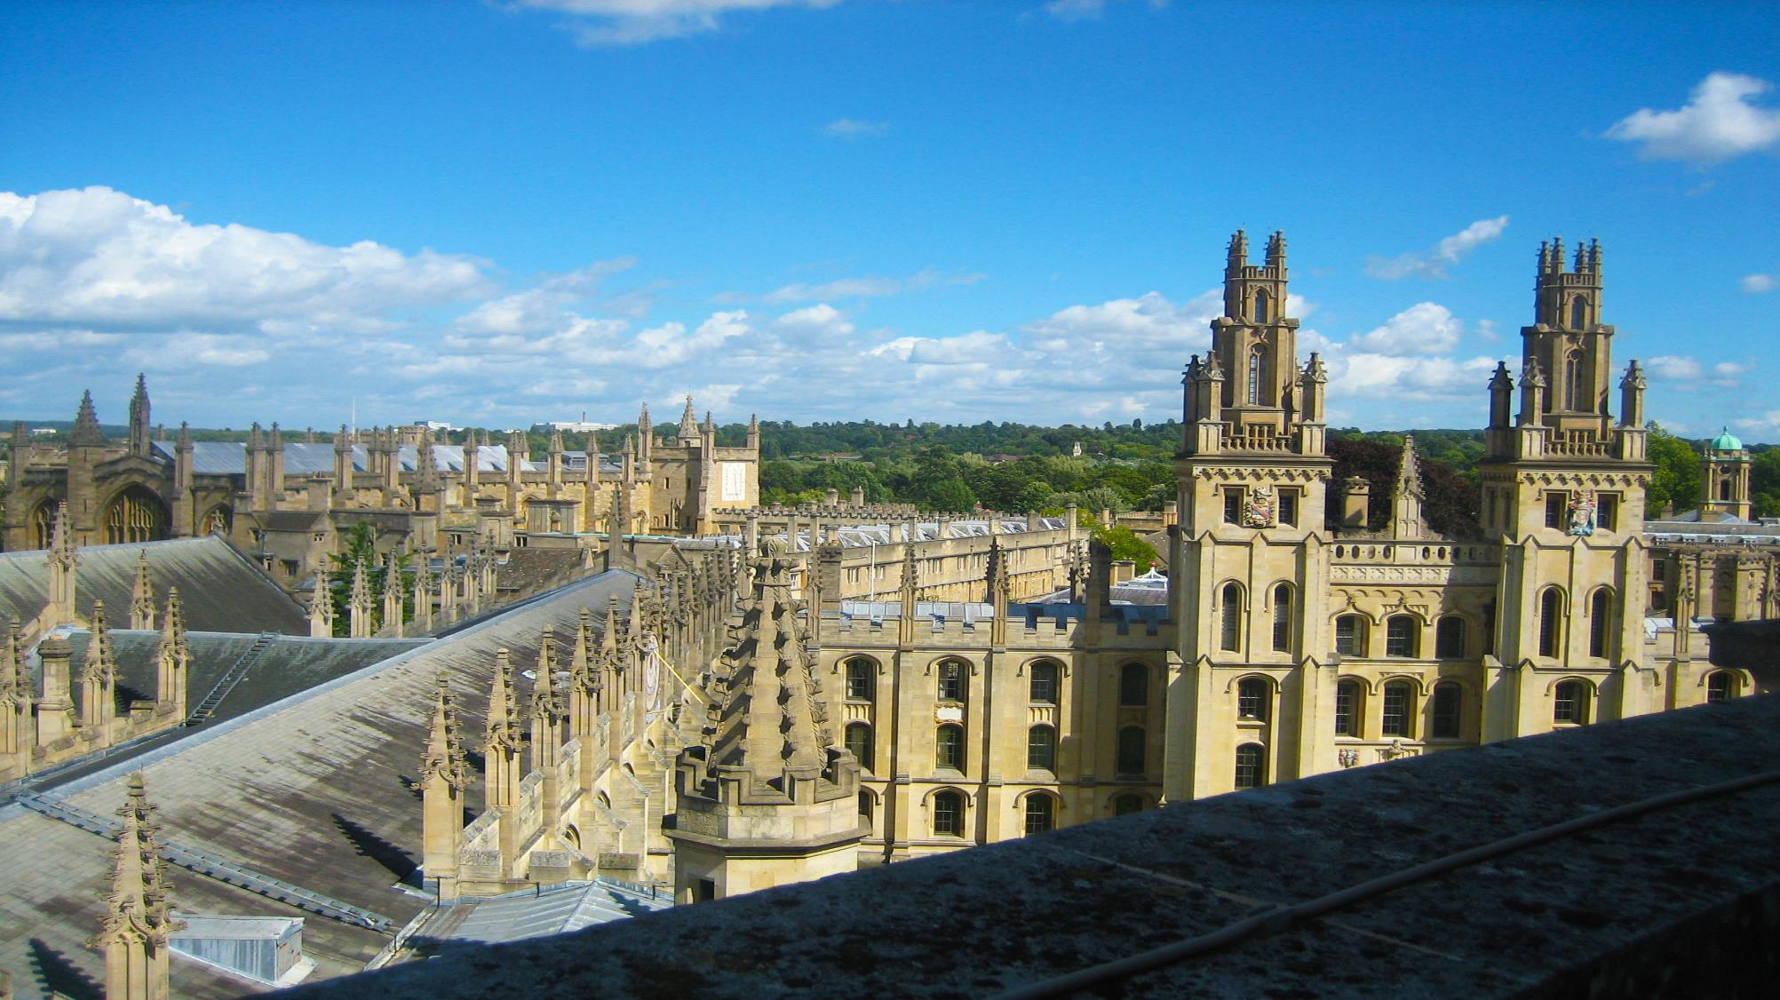


Bodleian Libraries Welcome
The presentation will begin shortly
This work is licensed under a Creative Commons Attribution 4.0 International License
Notes:
Hello and welcome to this Bodleian Libraries welcome webinar for new undergraduate and visiting students. We’ll be doing a combination of PowerPoint presentation and live demonstration.
The webinar will run through the basics of what you need to get started in the Bodleian Libraries and will last 30 minutes.
If you are interested, you can find the slides on our website: https://www.bodleian.ox.ac.uk/ask/getting-started/under-post-graduates#collapse3804121

Slide 2
Learning outcomes
Find and access items on your reading list
Network of the Bodleian Libraries
Computers, Wi-Fi, and Print, Copy Scan facilities
Disability support
Further help
Notes:
Moving on to what we’ll be covering today and the learning outcomes, by the end of this webinar, you will understand:
How to find and access items on your reading list
The network of the Bodleian Libraries
About the Computers, Wi-Fi, and Print, Copy Scan facilities
What disability support there is
And where to get further help
There will be a quiz part way to check your understanding too.

Slide 3

Meet Amy
Amy is a new first-year undergraduate student at Keble College studying Mathematics and Philosophy
Notes:
We are going to follow a student's journey as they settle into the University and how to use the Bodleian Libraries.
Meet Amy. Amy is a new first-year undergraduate student at Keble College studying Mathematics and Philosophy.

Slide 4

Your online reading list
The Faculty of Philosophy has published an online reading list and Amy needs to read a chapter in an ebook.
Notes:
The Faculty of Philosophy has published an online reading list and Amy needs to read a chapter in an electronic book (or ebook).

Slide 5
Accessing your online reading list
Amy accesses her course on Canvas via canvas.ox.ac.uk
And opens her ORLO reading list
Signs on with her Single Sign On (SSO) credentials
Notes:
Amy accesses her course on Canvas, which is the University’s Virtual Learning Environment for teaching and learning where you can access:
Course materials
Get feedback on your work
Start discussions and collaborate with other students or academics
Access your reading lists where available
Amy needs her Single Sign On credentials to log into Canvas, which she will have received ahead of her arrival at Oxford.
From her course in Canvas, she is able to open her OLRO reading list. ORLO stands for ‘Oxford Reading Lists Online’.

Slide 6
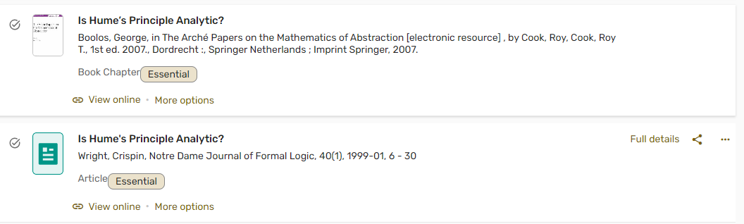
Find items in your online reading list: book chapters
Amy's online reading list shows live availability for books in libraries.
The chapter on her online reading list has a 'View Online' option.
Notes:
Amy's been told by her tutor that in the philosophy reading list there is a book chapter she needs to read called “Is Hume’s principle analytic?"
As Amy is unsure where to find it in the reading list, she uses the search function at the top of the page and enters the chapter title. There are two results with the same title [click the arrow on the left to open the results list]. The results list a chapter and a journal article. The book chapter is the one she was after. The chapter is in the book 'The Arché Papers on the Mathematics of Abstraction'. The book chapter shows as 'Essential' reading. Some items in reading lists will be marked as 'essential' in this way.
Below the title, there is a ‘View Online’ option. Amy clicks on it, and it takes her to the whole ebook on the provider's website. Because the link in the reading list was not a direct link to the chapter in the ebook, she searches for the chapter title from the table of contents.

Slide 7
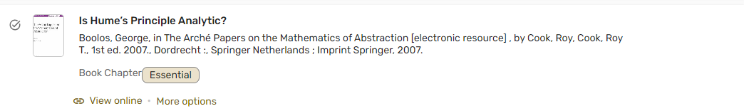
Find items in your online reading list: full details of book chapters
Amy checks the author’s details on her online reading list
Notes:
When Amy looks at the contents page in the ebook, she notices that there are two chapters with exactly the same title, one written by G. Boolos and one by C. Wright. Which one is she supposed to read?
She goes back to her reading list and checks the publication details under the chapter’s title, including the author, which shows as Boolos. Now she knows which of the two chapters with the same title she needs to read in the ebook.

Slide 8
Find items on your reading list: chapters in ebooks
Amy can now download the chapter on her device
Download limits may vary depending on ebook
However, she can always read the entire book online
The interface will differ depending on provider
Notes:
Amy goes back to the ebook home page and notices that she can read the whole book online (it says “Your institution has unlimited access to this book”), but she can only download a specific number of pages (it says "Get up to 195 pages"). This kind of detail may differ depending on which platform the ebook is on and the ebook itself. Thankfully, shed can download a whole chapter, which covers her needs. Even if she cannot download all the chapters she needs, she can always read the entire ebook online.

Slide 9

Find items on your Word or PDF reading list: book chapter
Amy has been given another reading list for maths in PDF format.
The reading list has a book chapter she needs to read.
Notes:
For more information about using ORLO, including some top tips, take a look at our Reading Lists web page: https://www.bodleian.ox.ac.uk/collections-and-resources/reading-lists
So far, we have been looking at Amy's online reading list in ORLO. Amy has been given another reading list for maths but this time it is in PDF format, not on ORLO.
While some courses use ORLO reading lists, other may choose a PDF or Word format.

Slide 10
Understanding your reading list: book chapters
chapter author
Book author
Chapter title
G. C. Smith, ‘Chapters 1 & 2’ in G. C. Smith, Introductory Mathematics: Algebra and Analysis, (London: Routledge, 1998).
book title
place of publication: publisher, date of publication
Notes:
Amy has an essential reading from that list to complete prior to her lecture. Amy happens to be in her college library and goes to the enquiry desk for help from the library staff. The staff explain the citation to her:
The chapter's author is G. C. Smith.
The chapters she needs to find don't have titles, they are chapters 1 and 2. She notes that the chapters' details come first in this instance
The chapter is in a book authored by G. C. Smith
The book title is Introductory Mathematics: Algebra and Analysis

Slide 11

Where to search for books: SOLO
Amy needs to check entries in her PDF reading list against SOLO, the University's resource discovery tool.
SOLO = Search Oxford Libraries Online
Notes:
Where does Amy need to go to search for the book?
The library staff explain that Amy needs to search for the book title and book author on SOLO, the University’s resource discovery tool, and stands for Search Oxford Libraries Online. Amy will need to check any references in her PDF reading list in SOLO. The information Amy needs is the book title and author.
Just to say that today we are demonstrating how to find a book on SOLO, but SOLO can be used to find lots of other reading list material, like journal articles.

Slide 12
Signing in to SOLO
To get the best results, sign in via solo.bodleian.ox.ac.uk/
Single Sign On (abcd1234)
Notes:
For the best results, Amy signs into SOLO with her SSO credentials via https://solo.bodleian.ox.ac.uk/
Logging into SOLO means you will see more results, especially for online material, and you can access your account where you will see your loans, and any requests you have placed.

Slide 13

Demonstration: SOLO
Notes:
Time to move on to a live demonstration of SOLO.

Slide 14
SOLO: simple search
Amy types into the search box the title of the book and the author's surname
Notes:
Here is the SOLO home page. For speed, I am already signed in with my Single Sign On credentials, but you will find the log in button in the top right of the screen, where you can see my name.
Remember from her conversation with the librarian earlier that she cannot put the whole citation from her reading list into a SOLO search and hope that she will find the chapter. Amy enters the book title and book author into SOLO.
[Enter Introductory mathematics: algebra and analysis Smith]
You hit enter on your keyboard or click the magnifying glass icon to the right of the search bar to submit your search.

Slide 15
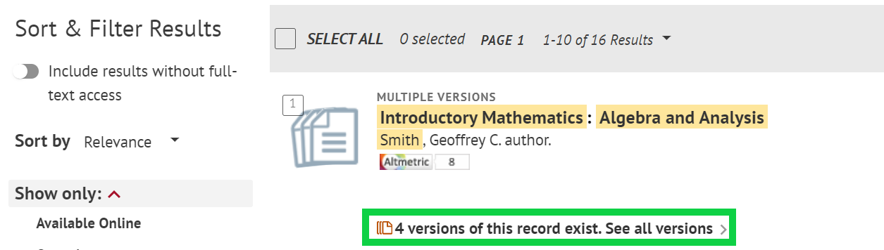
SOLO: ebook search results
Amy sees that there are multiple versions of the book available and clicks '4 versions of this record exist. See all versions'.
Notes:
Looking at the top search result, Amy sees that there are multiple versions of the book available and clicks '4 versions of this record exist. See all versions'. SOLO clusters print and online versions of the same title, as well as different editions.

Slide 16
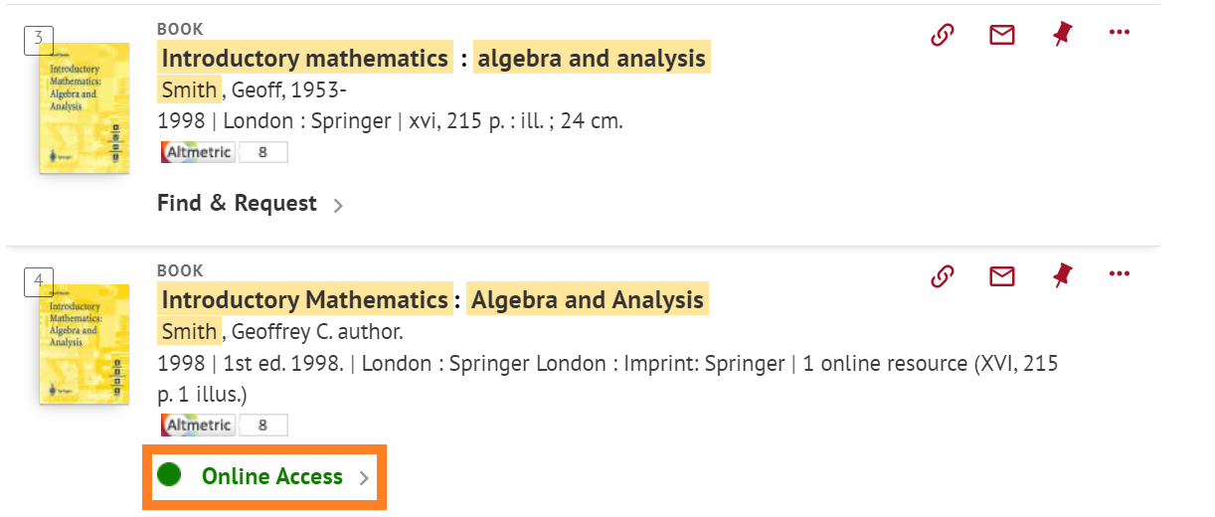
SOLO: online access to ebook
There is one online version of this book. Amy clicks 'Online Access'.
Notes:
There is one online version of this book. Amy clicks 'Online Access'.

Slide 17
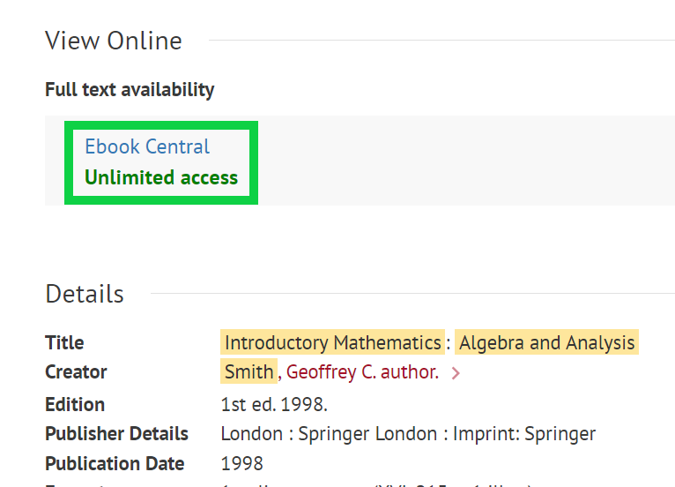
SOLO: link to ebook provider
SOLO opens the full record for the ebook.
Amy notes that there is unlimited access to the ebook
She clicks the link to the ebook provider.
The ebook opens in a new browser tab where Amy can then select the chapters she needs to read
Notes:
SOLO opens the full record for the ebook.
Amy notes that there is unlimited access to the ebook
She clicks the link to the ebook provider, in this case Ebook Central.
The ebook opens in a new browser tab where Amy can then select the chapters she needs to read [staff note: you don’t need to demonstrate browsing the chapters]

Slide 18
Find items on your Word or PDF reading list: book
Amy has been given a reading list for Philosophy in PDF format.
The reading list has a book she needs to read.
Notes:
Amy has been given a reading list for Philosophy in PDF format.
The reading list has a book she needs to read.

Slide 19
Understanding your reading list: book
Book authors
place of publication: publisher, date of publication
Mill, J. S. and Crisp, R., Utilitarianism, (Oxford: Oxford University Press, 1998).
book title
Notes:
Thanks to the help she received earlier from her college librarian interpreting a book chapter reference in her reading list, Amy can figure out that, in this case:
The book's authors are Mill, J. S. and Crisp, R.
The book title is Utilitarianism
The publisher details are Oxford University press and the book was published in 1998.
Because this is a PDF reading list, Amy needs to search for the book title and author on SOLO.

Slide 20
SOLO: searching for a print book
Notes:
[Navigate to SOLO’s simple search screen and enter: Utilitarianism Mill Crisp]

Slide 21
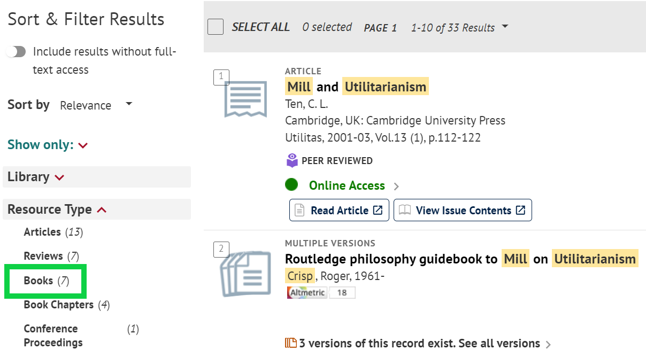
SOLO: Sort & Filter options
Amy cannot immediately find the book, so she uses the Sort & Filter options to filter to the Resource Type 'Books'.
Notes:
Amy cannot immediately find the book, so she uses the Sort & Filter options to filter to the Resource Type 'Books'.

Slide 22
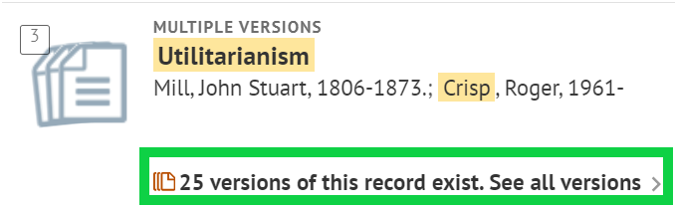
SOLO: print book results
Amy sees that there are multiple versions of the book available and clicks '25 versions of this record exist. See all versions'.​
Notes:
[The book is the third result.]
Amy sees that there are multiple versions of the book available and clicks '26 versions of this record exist. See all versions'.​

Slide 23
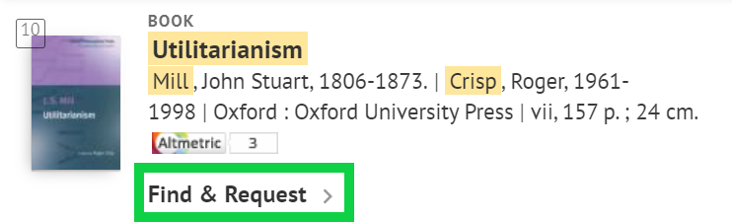
SOLO: Find & Request
Amy finds the 1998 print copy of the book and clicks 'Find & Request'.
Notes:
Amy finds the 1998 print copy of the book [11th in the results list] and clicks 'Find & Request'.

Slide 24
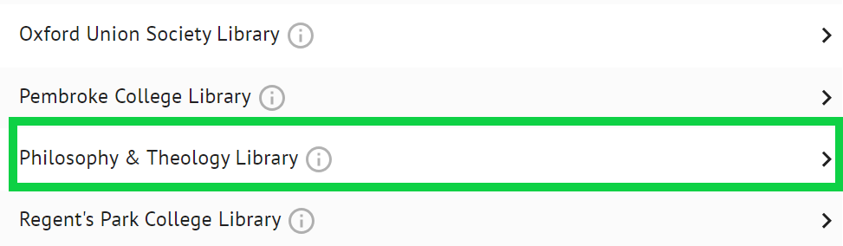
SOLO: which libraries have copies of the book?
Amy finds that her college, Keble, does not have any copies of the book, but the Philosophy and Theology Library does, which any member of the University can use.
Notes:
This brings up a list of libraries that have a copy of the book. Amy finds that her college, Keble, does not have any copies of the book, but the Philosophy and Theology Library does, which any member of the University can use.

Slide 25
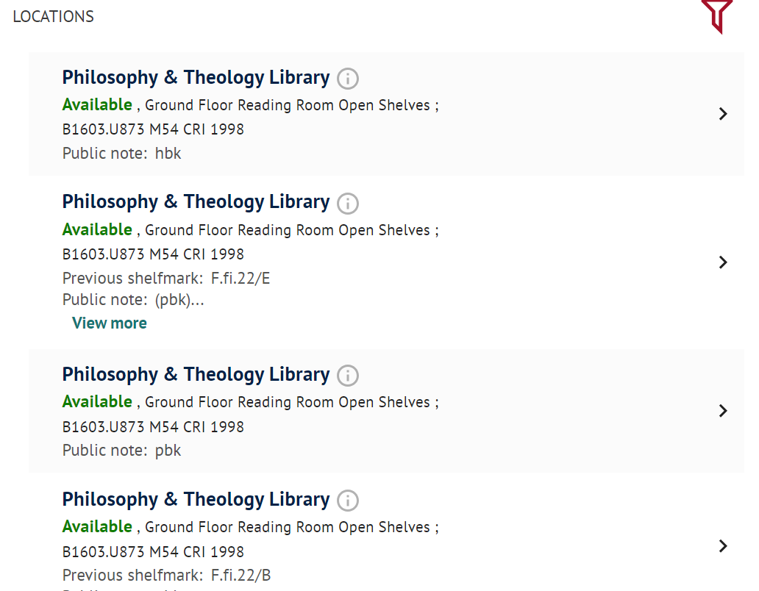
SOLO: library details for the print book
The Philosophy and Theology Faculties Library has multiple copies of the book, which are available.
Amy notes the shelf mark B1603.U873 M54 CRI 1998 and the location 'Ground Floor Reading Room Open Shelves'.
Notes:
[Click ‘Philosophy & Theology Library’ in SOLO]
The Philosophy and Theology Faculties Library has multiple copies of the book, which are 'Available'. Amy clicks one of the copies and sees additional information: 'Item in place' and 'Loanable'.
Many of the Bodleian Libraries' books are available on the open shelves, like this one. This means that you can walk into the library and take the book off the shelf yourself. You can usually see this where the book is in the library from the 'item location' – which will vary depending on where you're collecting the book from. In this case, the item lives in the 'Ground Floor Reading Room Open Shelves'. You can also see the shelf-mark here (B1603.U873 M54 CRI 1998), which tells you where in the library you can find the book. So it should be really easy for Amy to go to the library and pick up the book she wants! If a book is available on the open shelf, it's often faster to collect it yourself.

Slide 26
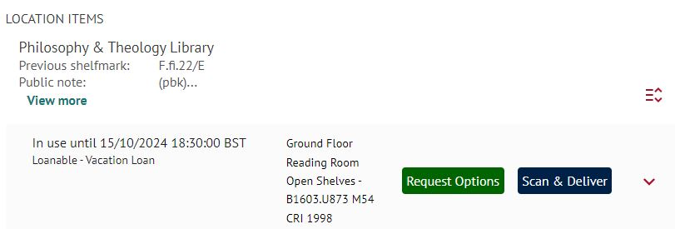
SOLO: request options
If a book is on loan, this will be made clear in SOLO by saying "on loan".
If there aren't any other copies available, you can place a request.
Notes:
I am going to click ‘Back to locations’ to see a list of all the copies of the book this library has. If a book is on loan, this will be made clear in SOLO by saying ‘Check availability’. If I click the item, I get further information: ‘on loan’ and it will say 'In use until'.
In this case, the book is in use until 15/10/2024.
You'll see that there's a 'Request Options' button. If you click, you can place a request on the item. This means the person using the book will be asked to bring the book back to the library by the date listed. When it's returned, you'll be notified, and the book will be set aside for you to collect in the library. This is a free service.
There is also the 'Scan & Deliver' button next to the Request Options. This option means that library staff will scan the item for you and send it to you in PDF format via email. If you cannot make it to the library to collect a physical copy of a book, this is a good option. Things to note about Scan & Deliver:
You can place up to two requests at any one time;
You may only request up to one chapter or article from a book or journal issue, as governed by copyright legislation;
Requests are normally fulfilled within seven days.
Scan & Deliver is free!

Slide 27
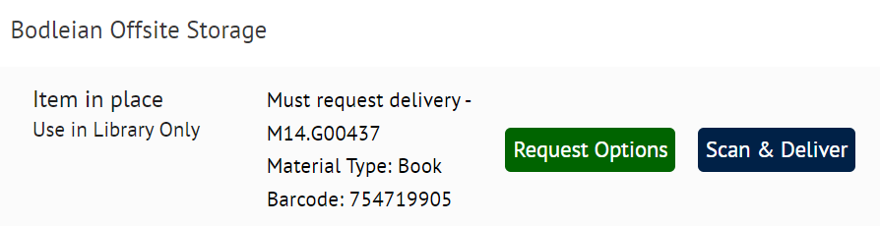
SOLO: Offsite storage
Some books, like this copy of Utilitarianism by John Stuart Mill, are in offsite storage and need to be ordered to a library to read there. Click 'Request Options'.
Notes:
Some of our books can't be taken out of the libraries; they can only be read inside. [Navigate back to cluster of books by clicking 'x' on the left'.] If I show you quickly the newer 2014 copy of this book [4th book in results list] and click 'Find & Request', you can spot that the book cannot be borrowed because it says 'Use in Library only'. It is at the Bodleian Offsite Storage and says Must Request Delivery and you do that by clicking 'Request Options' [click ‘Request Options’].

Slide 28
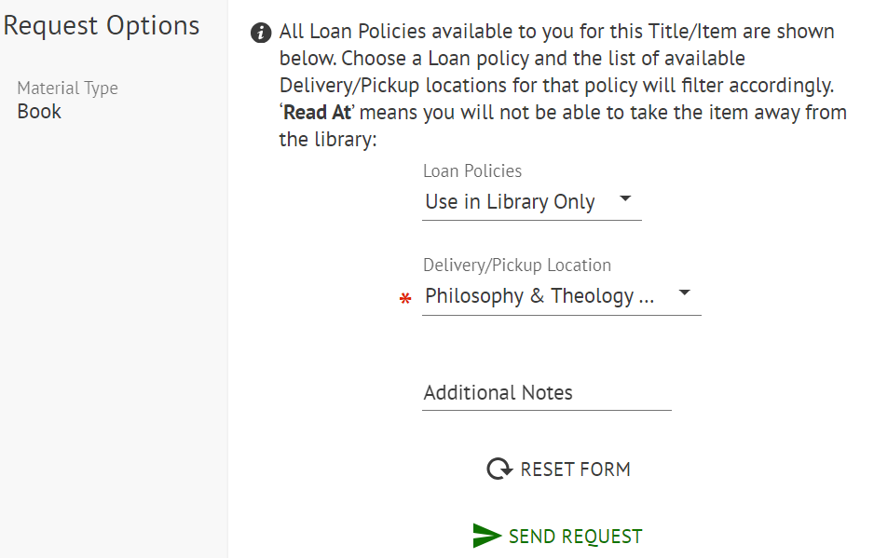
SOLO: request options
Note that the book is for 'Use in Library Only'.
You are only given 'Read at' locations.
Notes:
When you try to request the book, you'll only be given the yellow 'Read at' locations, rather than green 'borrow from' locations which you might see when requesting loanable books [click the ‘Delivery/Pickup Location’ dropdown to show the ‘Read at’ options].
You will also only be given the 'Use in Library Only' loan policy option [click on the ‘Loan Policies’ dropdown and select ‘Use in Library Only’].

Slide 29
Summary of finding books on your reading list
Reading lists may be online via ORLO or in a PDF/Word format.
Online reading lists: you can click through to read a book online.
PDF/Word reading lists: search for books via SOLO.
SOLO: look for copies in your subject library and college library which show both ‘Item in place’ and ‘Loanable’.
Print books: it is usually easiest to go to the library and take the book of the shelf.
Notes:
What has Amy learned about finding items on her reading lists?
Reading lists may be online via ORLO or in a PDF/Word format.
With online reading lists, you can click through to read a book online.
With PDF and Word reading lists, you need to search for books via SOLO.
On SOLO, look for copies in your subject library and college library which show both ‘Item in place’ and ‘Loanable’.
For print books, it is usually easiest to go to the library and take the book off the shelf yourself.

Slide 30
Summary of placing requests
If a book is on loan, use the 'Request options' to place a hold on a book.
Use 'Scan & Deliver' to receive a PDF copy of a book chapter or journal article.
If there are no 'In Place' items, then it is likely the only copy available to you is a print copy from offsite storage.
Notes:
What has Amy learned about finding items on her reading lists?
Reading lists may be online via ORLO or in a PDF/Word format.
With online reading lists, you can click through to read a book online.
With PDF and Word reading lists, you need to search for books via SOLO.
On SOLO, look for copies in your subject library and college library which show both ‘Item in place’ and ‘Loanable’.
For print books, it is usually easiest to go to the library and take the book off the shelf yourself.

Slide 31

From SOLO to the library
Whilst in SOLO, Amy checks out information about the Philosophy and Theology Faculties Library before her trip and clicks the 'i' information button.
Notes:
Now equipped with this information, Amy is ready to head out to the library and get her book! So what comes next?
As we saw earlier, Amy has found out through SOLO that one of the books from her reading list is available at the Philosophy and Theology Faculties Library.
First things first, she needs to find out where that library is.
[Navigate to SOLO in web browser and return to 1998 copy of Utilitarianism by Mill in SOLO (11th results) and the PTFL copy]
Click the information button ['i' in circle]
This will take you directly through to the information about a particular library on the Bodleian Libraries website – in this instance, the Philosophy and Theology Faculties Library.

Slide 32
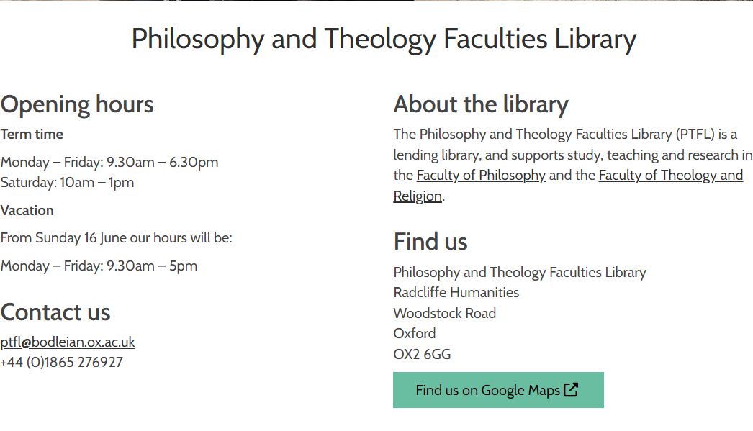
Information about the library
The website shows opening hours, the address and contact details.
Notes:
Most usefully for Amy, we can see the opening hours of the library, as well as its address. Amy knows this location; this library is close to both the mathematics and philosophy faculties, so it's very easy for Amy to get to.

Slide 33
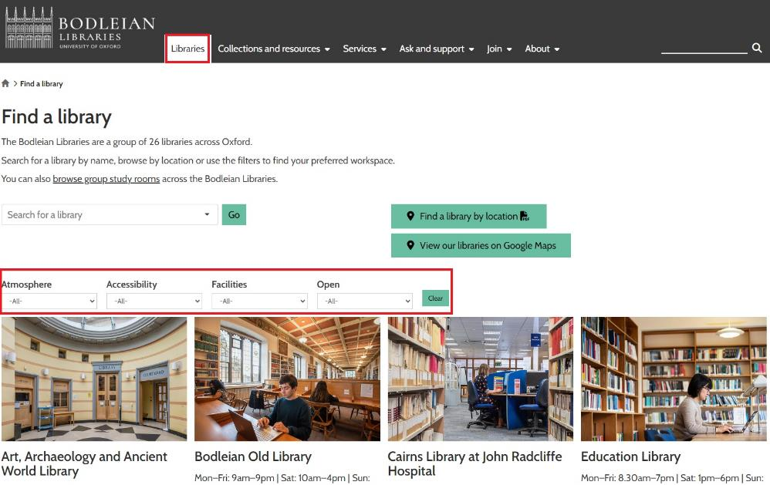
Finding a study space
Amy is looking for a study space.
The Libraries page on the website lists all the 26 Bodleian Libraries and allows you to filter by, for instance, accessibility.
There are also departmental and college libraries at the University.
Notes:
But Amy doesn't just want to borrow a book – she's also looking for somewhere she can sit down and study for a few hours with a nice cup of coffee.
If we click this 'Libraries' button at the top of the page, this gives you a list of all 26 Bodleian Libraries. That's quite a lot of libraries to choose from! But helpfully, you can filter them by lots of different factors – for example, accessibility, available facilities, opening hours, and even whether or not you can bring your own coffee in a keep-cup! [Click 'Atmosphere' dropdown and ‘Hot and cold drinks allowed (KeepCups)'].
Luckily for Amy, the Philosophy and Theology Faculties library allows KeepCups.
It is worth noting that some departments also have their own libraries, for example Earth Sciences.
Each of the colleges has its own library too. Whilst you can use any of the Bodleian Libraries, you can only use the library in your college.

Slide 34
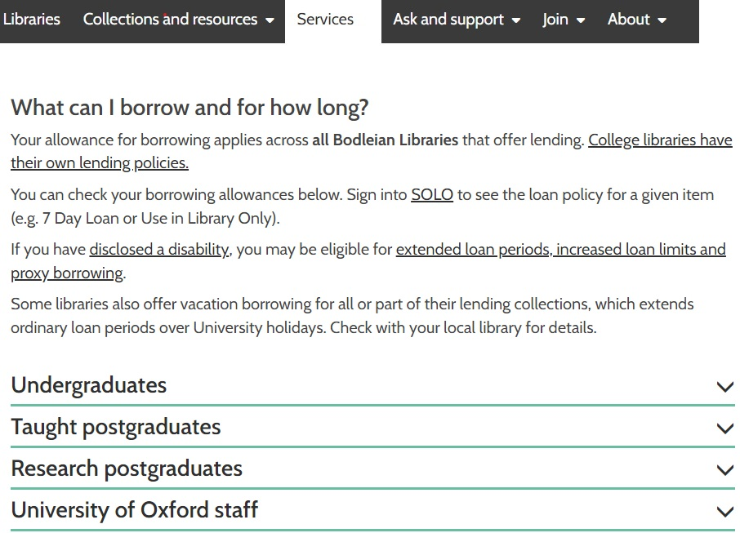
Borrowing permissions
Amy checks how many books she can borrow.
20 items across the Bodleian Libraries for seven days.
Loans will automatically renew for max. 16 weeks.
Unless requested by another reader – return the book asap!
Overdue books = blocked from borrowing
College libraries have separate rules about borrowing.
Notes:
But there's one more thing Amy wants to check before she goes to get her books. She wants to know how many books she can borrow at once – she's got a lot of reading to do, so she needs to keep an eye on how much she's borrowing! If you hover over these menus at the top of the page, open the 'Services' menu and click 'Borrow & Reserve'. [CLICK] This page will give you a lot of helpful information about borrowing, including – most helpful to Amy – information about loan limits for Undergraduates [scroll down the page and click 'Undergraduates']. There's a lot of detail here, but the headlines are:
That she can borrow up to 20 items across the Bodleian Libraries
Loans will automatically renew for max. 16 weeks.
Unless requested by another reader – in which case return the book asap!
If you have overdue books, you will be blocked from borrowing
Amy’s college library will have its own separate rules about borrowing.

Slide 35
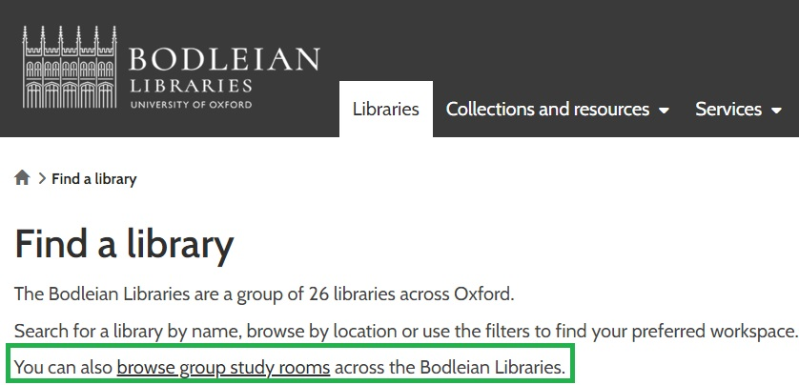
Study rooms
Browse and book group study rooms in the Bodleian Libraries.
Notes:
In addition to the assigned reading, Amy's tutor has asked that students meet up in small groups of four to discuss the book ahead of the lecture.
Luckily for Amy, the Bodleian does offer group study rooms – some on a walk-in basis, some bookable in advance. If we go back to the 'Libraries' page and follow this 'browse group study rooms' link, we can see a full list of study rooms. This will detail what library they're in, what the capacity is, and what equipment is available.

Slide 36
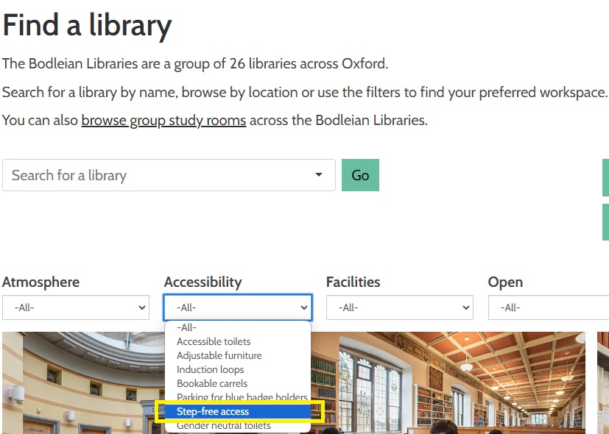
Accessible spaces
One of the friends in Amy's group needs a library with step-free access.
The Libraries page of the website offers filtering by the option 'Step-free access'.
Notes:
Now, Amy knows that someone in her group needs step-free access. So if we go back to the libraries page, filter by 'step-free access' under 'Accessibility', we can see which libraries are most-easily accessible for her study-group.

Slide 37
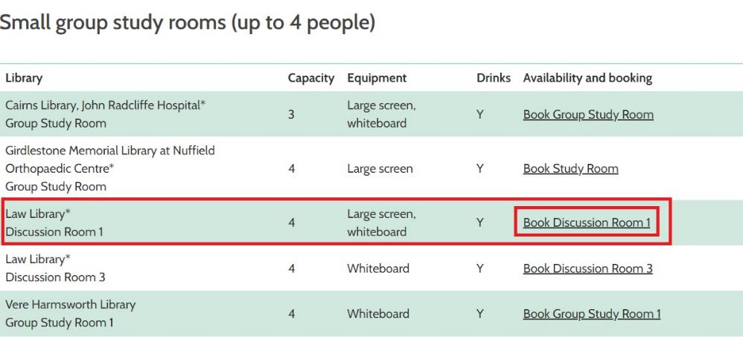
Booking a study space
View study room details and book a slot.
Notes:
Checking both lists against each other, Amy looks down the table and sees that the Law Library has a room for four people and the Libraries web page shows the Law Library as having step-free access. If we click 'Book Discussion Room 1’, you can see that the description confirms step-free access is available for this room. She can book the room for her study group in advance by using the tool at the bottom of the page [staff note: don't demonstrate].

Slide 38

Accessing the Bodleian Libraries
Amy needs to make sure she remembers her University card to get into the building!
Notes:
So now Amy knows where to find her book and how to borrow it. The last thing she needs is her University Card – or Bod Card, as we sometimes call them. You'll need to use this card to get into all university buildings and libraries – most doors will have a card reader on them.

Slide 39

Print, copy, scan
Amy wants to scan a chapter of a book and add some credit so that she can print her essay later in the week.
She visits register.bodleian.ox.ac.uk and enters her University Card barcode number to create a password for accessing the PCAS service.
Scanning is free of charge
Add credit for copying and scanning at
https://pcas.bodleian.ox.ac.uk
Notes:
While borrowing her books from the Philosophy and Theology Faculties Library, Amy notices an interesting-looking book at the Library Reception called "Decision theory: an introduction to the mathematics of rationality".
She knows her tutor mentioned a chapter in this book which is especially useful for one of her upcoming essays.
She asks the library staff whether she can use the book and they explain that it is for Use in the Library Only, but she would be welcome to photocopy or scan a chapter of the book for herself, using the PCAS Service.
Amy asks what PCAS stands for and the staff member explains that it stands for Print, Copy and Scan, and shows Amy a leaflet explaining how she can get started using PCAS. Her username is her university card barcode number, and she can set a password at https://register.bodleian.ox.ac.uk/ They also explain that scanning is free of charge, but Amy would need to add some credit to her account to make a photocopy or to use the service to print, and credit is added via the web address at the bottom of the slide.

Slide 40
Print, copy, scan
Amy taps her card on the card reader and enters her username and password; her card is now linked to her account.
She scans the pages she needs and receives the PDF by email.
She notices that she is allowed to scan one chapter per book.
She adds credit for printing at pcas.bodleian.ox.ac.uk
Notes:
Amy decides to scan the chapter and email it to herself. She finds the PCAS machine on the ground floor of the library and taps her card on the card reader.
She then enters her account details. Helpfully, that means her card is now linked to her PCAS account so all she needs to do in future to use any of these machines in any of the Bodleian Libraries is tap her card.
The machine automatically fills in her college email address, so she scans the pages she needs, and the PDF appears in her emails on her phone straight away.
She can see the copyright notice on the wall says that she can scan one whole chapter of the book and stay within UK copyright laws, but she wouldn't be allowed to scan more than one chapter from the same book.
Amy knows she would like to print out the first draft of her essay later in the week, so she goes to pcas.bodleian.ox.ac.uk and adds some credit there ready for when she has finished the draft.

Slide 41

Wi-Fi
Amy has brought her laptop to the library and wants to work on her essay and download some online articles.
She connects to the network using Eduroam.
Her laptop unfortunately runs out of battery, and she has forgotten her charger, so she uses a library PC to finish the essay.
Notes:
Amy settles into the reading room of the Philosophy and Theology Faculties Library and gets out her laptop to work on her essay.
She wants to connect it to the Wi-Fi network, so she looks in her list of networks and sees Eduroam, which she has already used in college, and in the department.
She also sees 'Bodleian-Libraries' in the list of networks. She could connect to that network instead, using the same details she used to sign in to PCAS.
Unfortunately, her laptop is running out of battery power, and she has forgotten her charger.
She asks to borrow a charger at the library desk. The library normally has one but unfortunately it has already been borrowed by another student.
The library assistant suggests using a library PC instead.
He explains that to log in to a library PC, Amy needs to use the same Bodleian Libraries login details she used for the PCAS service.

Slide 42
Wi-Fi, PCs, Printing and Passwords
Use your Bodleian Libraries username and password to access:
  Bodleian Libraries Wi-Fi
  Library PCs
  Print, Copy and Scan (PCAS)
Set password www.bodleian.ox.ac.uk/services/library-account
It is different to the Oxford Single Sign On (abcd1234)
Notes:
What has Amy learned here?
That there is a Bodleian Libraries username and password which is separate from your Single Sign On credentials. This account is used for:
Connecting to the Bodleian Libraries Wi-Fi
Logging on to the reading room PCs
The Print, Copy and Scan facilities
The password is set at the web address you see on the slide.

Slide 43

Disability
Amy has dyslexia and is worried she won't be able to read her books by their due date.
She mentions this to a member of staff at the Philosophy and Theology Faculties Library and explains she is also very tired with fatigue from long covid.
Notes:
Amy has dyslexia and is worried she won't be able to read her books by their due date.
She mentions this to a member of staff at the Philosophy and Theology Faculties Library and explains she is also very tired with fatigue from long covid.

Slide 44
Disability support
Local Disability Liaison Librarians
Bodleian Libraries' Disability Librarian bodleian.ox.ac.uk/services/disabled-readers
SensusAccess: converts documents into alternative formats
Adjustable furniture in libraries
Notes:
The Philosophy and Theology Faculties Disability Liaison Librarian points Amy towards the Bodleian Libraries' Disability Librarian. Information is on the web page you see on the slide [ask co-presenter to add https://www.bodleian.ox.ac.uk/services/disabled-readers to the chat]
After speaking to the Disability Librarian, Amy learns that she can use SensusAccess for free, which converts documents into alternative formats. She likes the idea of converting some of her reading into an MP3 file so that she can listen to it on the move.
While looking at the SensusAccess information on the Bodleian Libraries website, Amy also notices that the libraries have adjustable furniture.

Slide 45
Support available when referred from the Disability Advisory Service
Disability Advisory Service ox.ac.uk/students/welfare/disability
Extended loan allowance
Increased loan limit
Proxy borrowers
RNIB Bookshare membership
ARACU support
Notes:
The Disability Librarian signposts Amy to the University's Disability Advisory Service because they will be able to provide recommendations for support including:
extended loan allowances, and
increased loan limits, both of which Amy is interested in to give her more time to read the books on her reading lists.
the Disability Advisory Service can also arrange for proxy borrowers (a person to collect books from a library on another person's behalf), membership of the RNIB bookshare (a database of accessible texts available to print-disabled people), and ARACU support, who provide alternative formats to printed material.

Slide 46
Support with finding material
The Bodleian Libraries does not have a copy of the book: Amy fills in the Recommend a Purchase form bodleian.ox.ac.uk/collections-and-resources/recommend-a-purchase
Amy cannot find a book that she wants to read.
She talks to her subject librarian bodleian.ox.ac.uk/ask/subject-librarians
Notes:
The following week, Amy cannot find a book that she wants to read.
She talks to the philosophy subject librarian who she finds via the Subject Librarians web page on the Bodleian Libraries website [co-presenter to add bodleian.ox.ac.uk/ask/subject-librarians to the chat].
The subject librarian confirms that the Bodleian Libraries does not have a copy of the book: Amy fills in the Recommend a Purchase form bodleian.ox.ac.uk/collections-and-resources/recommend-a-purchase

Slide 47
Further help
Ask library staff in-person
Live Chat
Email the subject library
Email your subject librarian
Email reader.services@bodleian.ox.ac.uk
Notes:
The subject librarian makes Amy aware of all the ways she can get further help if she needs it in the future. Amy can:
Ask library staff in-person when she is in the library
Use the Live Chat service, available on SOLO and on the Bodleian Libraries website
She can email her subject libraries, details of which are on the website
She can email her subject librarian whenever she wants, as she has already done
She can contact the central Reader Services team, who are very knowledgeable and can be contacted about anything in the Bodleian Libraries [co-presenter to add reader.services@bodleian.ox.ac.uk to the chat].

Slide 48
Summary of Welcome webinar
Finding and accessing items on your reading list
Network of the 26 Bodleian Libraries
Computers, Wi-Fi and PCAS
Disability support
Further help
Scan & Deliver
Notes:
To summarise what you have hopefully learned by the end of this presentation, we have covered:
How to find and access items on your reading list, using ORLO and SOLO
The network of the 26 Bodleian Libraries and its services, such as borrowing permissions, study rooms and accessible spaces
Computers
Wi-Fi
PCAS
The Scan & Deliver service
Disability support
Further help

