Slide 1
Welcome to Referencing: RefWorks
Beth Paton, Gigi Horsfield, Helen Scott

Slide 2
Aims
To enable you to:
Understand the main features and benefits of RefWorks
Import references from different sources into RefWorks
Manage your references in RefWorks
Insert citations into documents
Create a bibliography/reference list

Slide 3
Reference management software benefits
Staying organised
Stores information about books and papers you may want to cite in one place
Saving time
Formats your in-text citations, footnotes and bibliographies
Allows you to switch citation styles easily
Notes:
There are two main benefits to using reference management software
It allows you to keep references to everything you’ve read in one place. This means that when you come to write a paper and you need to cite a book, article or other item, you have all the information you need to hand. For example, if you need to cite a journal article, you’ll need the name of the author, the article title, the title of the journal, the volume and issue number and the page numbers. This kind of information is difficult to remember, but if its in your reference manager, you’ll have it when you need it.
It also saves you time because it will format your references or citations for you according to the rules set down in your chosen citation style. For example, it will put the different parts of the citation in the correct order and use the correct punctuation and capitalisation. It will also change citation style for you easily. So for example, if you are writing in Harvard style but then submit an article to a journal which requires the MLA style, you can switch all your references over in a couple of minutes.

Slide 4
Software options…
CC BY 2.0, Mendeley Team
CC BY SA 4.0, Hurrigans
Notes:
A number of products available.
The most well known are RefWorks and Endnote…but there are a host of others too. Mendeley and Zotero have become particularly popular over the last few years.

Slide 5
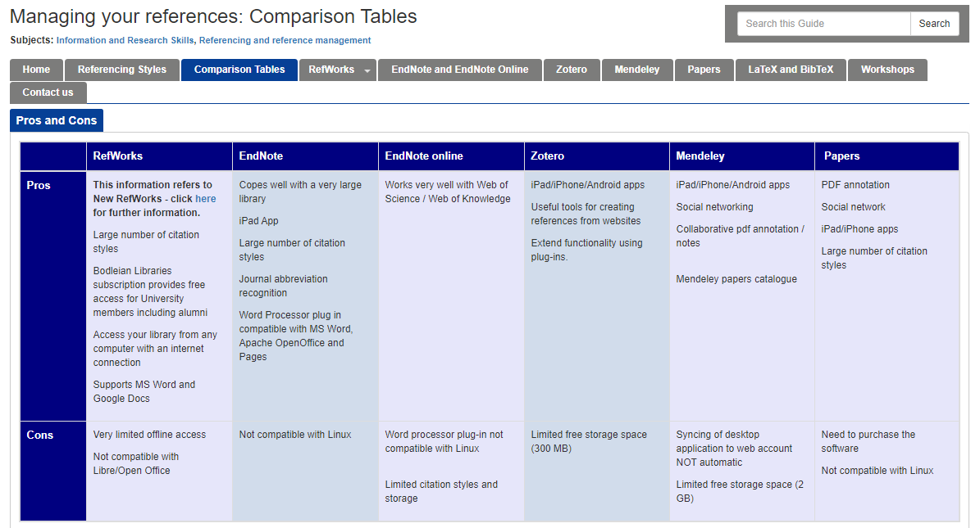
Which one is best?
libguides.bodleian.ox.ac.uk/reference-management
Notes:
People always ask, which is the best reference manager?
This is an impossible question to answer because it depends on a lot of different factors and your own personal preferences.
For example
some of the software is free whereas other packages such as Endnote have to be paid for.
Some packages save references online (in the cloud) whereas others store your references on your hard disk.
Some packages only work with Microsoft Word, whereas other packages may work with Libre Office as well as Word
If you want to find out more about the differences between the various packages and there pros and cons look at the reference management LibGuide

Slide 6
Getting started with RefWorks
Free for students and alumni.
There are 2 versions of RefWorks.
Cloud based: accessed from any computer/device connected to the internet; won’t work well offline.
Works well with MS Word (Windows and Mac) and Google Docs.

Slide 7
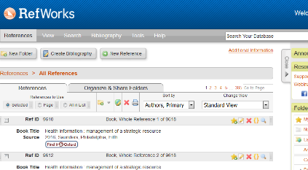
RefWorks versions
ProQuest RefWorks (new RefWorks) – this is what we are looking at today!
Legacy RefWorks (older version)

Slide 8
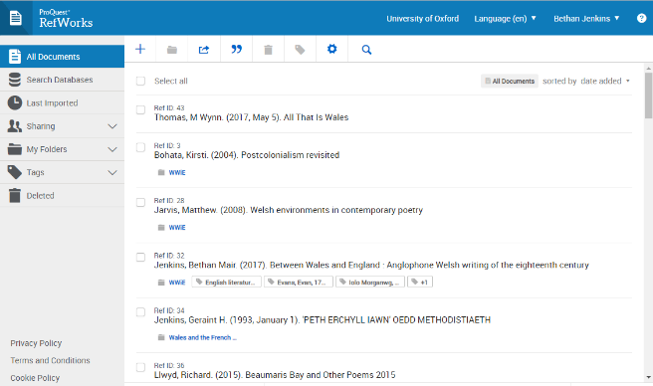
ProQuest RefWorks
Launched Spring 2016
Recommended for new users
We will be covering ProQuest RefWorks today

Slide 9
Setting up a refWorks account

Slide 10
Setting up accounts
Setting up accounts
Two Options:
Oxford Email
Oxford SSO
NB - You can now switch between the two by clicking on your name & going into ‘Settings’ (see FAQs for details)
10

Slide 11
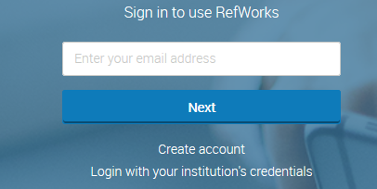
Setting up an account
Go to https://refworks.proquest.com/ *(avoid refworks.com - this is the legacy version)
Click “create account” to sign up using your email address
OR Login with your institution's credentials = SSO
11
Notes:
The address is different to old RefWorks. If you Google RefWorks you will probably find Legacy RefWorks. Be careful what you search!
Do a Demo now.

Slide 12
Adding References
Photo by Dom J from Pexels

Slide 13
Options for importing references
Options for adding references
Enter references manually.
Export references from databases (works for most but not all databases).
Import references from databases using saved files – usually in plain text format with tagged fields.
Use the “Save to RefWorks” plug in.
Drag and Drop PDFs into RefWorks.

Slide 14
Adding a reference manually

Slide 15
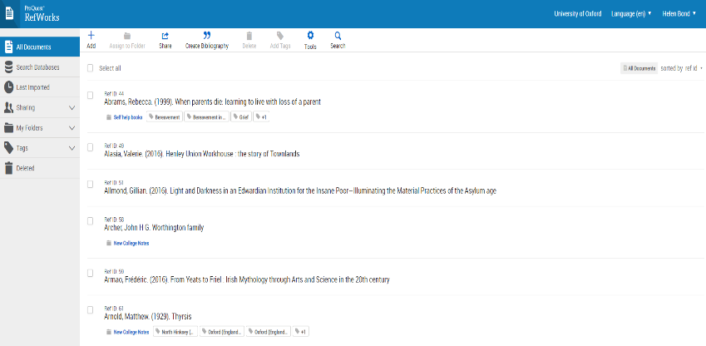
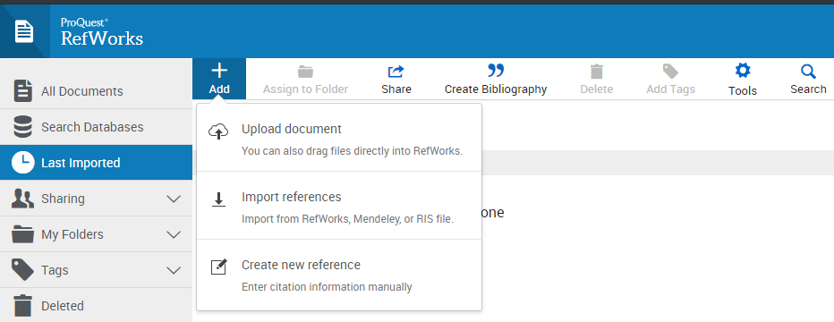
Adding new reference manually (1)
Adding reference manually (1)
1. Click on the + sign on the top left of the toolbar:
2. Choose “Create new reference: Enter citation information manually”

Slide 16
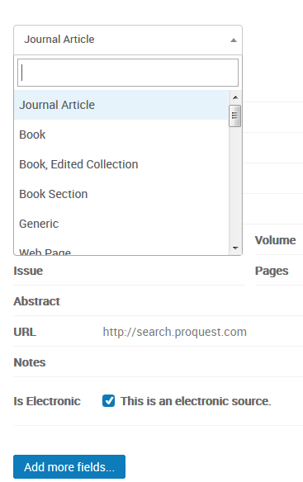
Adding new reference manually (4)
Adding reference manually (2)
3. Choose a material type from the drop down menu (e.g. journal article, book, thesis, web page etc.) Note - There are several different types of ‘Book’
“Book” = standard book by one or more authors
“Book, Edited Collection” = edited collection of chapters/essays by multiple authors
“Book, Section” = Chapter
4. If the item is electronic (e.g. an e-journal/e-book) tick the check box. This will ensure that any extra information required for e-resources by your citation style is included
Notes:
Click on the dropdown menu for the material type (which autofills initially to be “Journal Article”) and scroll down to find the type of material you want to enter, e.g. Book, Thesis, Conference Proceedings, Newspaper Article, and select that. Note! There are several different types of ‘Book’ – make sure you select the appropriate heading. “Book” = single-author work, “Book, Edited Collection” = multi-author works, and so on.
Be sure you have the correct information regarding whether the item is either print or electronic. This will determine if certain fields of information print in your bibliography as specified by your citation style. An example would be printing a DOI number. If the electronic source type is not set, this will not print. If the required field is not offered you can add it (eg URL for e-book etc.)
DEMO – add in manually Laura Mulvey / Visual and Other Pleasures (Basinstoke: Palgrave Macmillan, 2009) 2nd ed. Tags – basically like subject headings (eg if you import from SOLO this is where subject headings go)

Slide 17
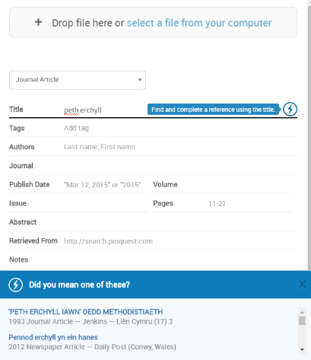
Adding new reference manually (5)
Adding reference manually (3)
5.Fill in the form. The fields shown by default are required by most citation styles –try to fill in as many as you can!
7. Once you have started filling in details you can use the lighting symbol to ask RefWorks to find suggested titles.
Use with care – citation data may be inaccurate.
Notes:
Start filling in the title, author etc. One option in New RefWorks is autofill for titles, using the lightning symbol - suggestions through which to scroll will appear on the bottom, and if one matches the material you wish to fill in, you can select it. It is doubly important to check all the fields in your reference if you do this, as there is no guarantee of the quality of the data entered! (e.g. I had to remove authors’ titles from one automatic suggestion, and change the ref type). If you don’t want these suggestions, click on the X on the right of the blue suggestions bar at the bottom
DEMO – eg Home is Where the Heart Is: studies in melodrama and the women’s film / Christine Gledhill

Slide 18
Direct Export
Many interfaces allow direct export from databases:
EBSCOHost, OvidSP, Proquest, Scopus, Web of Science…
Warning
Exported records may need editing
If you do not edit your records this will lead to errors in your bibliographies and citations

Slide 19
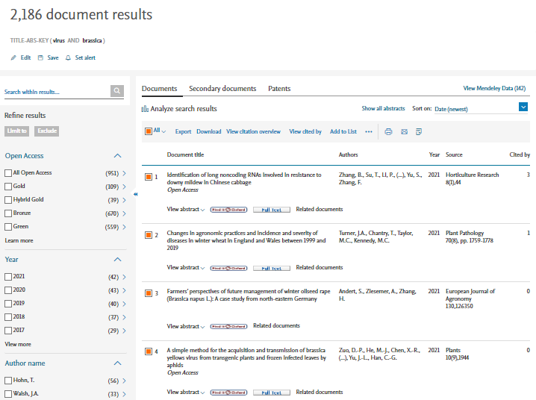
SCOPUS (1)
Notes:
Scopus is a bibliographic database for science, medicine and some social sciences. Access Scopus by searching for Scopus in SOLO (http://solo.bodleian.ox.ac.uk/ ) and then following the Online access link. Alternatively, search for Scopus on Databases A-Z (https://libguides.bodleian.ox.ac.uk/az.php ). If you are off campus, you will need to use your Oxford Single Sign On (SSO) credentials to use it.
Running a Basic Search
When you enter Scopus, you will land on the main search page.
Enter your keywords into the search box and select ‘Article Title, Abstract, Keywords’ from the adjacent dropdown menu. Click the Search button. After a few minutes your search results will appear on screen
Selecting records for export
Choose records you wish to export to RefWorks.
To select individual references, tick the checkbox adjacent to each record.
A whole set of results or whole page of results can be selected simultaneously by ticking the downward arrow next to ‘All’ at the top of the results list.
Once you’ve selected the required records click Export
Select ExLibris RefWorks as your method of export
Click on Export
You will then be asked if you wish to export to RefWorks. Select Yes, export to the newest version of RefWorks.
RefWorks will open in your browser. If you’re not logged in, you’ll be prompted for your username and password.
Click on Import – you can choose to import into a Folder at this stage or do so at a later stage. Click on OK to view the record in your “last Imported” folder.

Slide 20
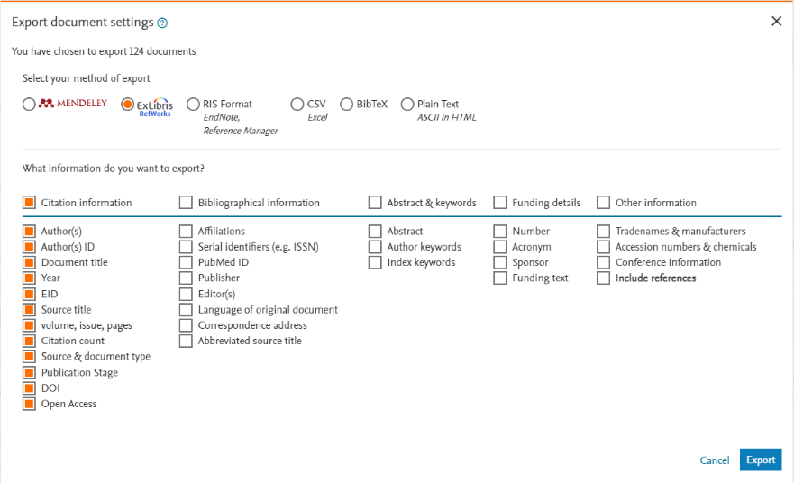
SCOPUS (2)
Notes:
Once you’ve selected the required records click Export
Select ExLibris RefWorks as your method of export
Click on Export
You will then be asked if you wish to export to RefWorks. Select Yes, export to the newest version of RefWorks.
RefWorks will open in your browser. If you’re not logged in, you’ll be prompted for your username and password.
Click on Import – you can choose to import into a Folder at this stage or do so at a later stage. Click on OK to view the record in your “last Imported” folder.

Slide 21
SOLO
Notes:
SOLO
SOLO is the resource discovery tool for the major collections of the libraries of the University of Oxford. It covers physical holdings in the majority of the libraries which includes the Bodleian Libraries and most Faculty/Department and College libraries. It also provides access to electronic material including e-books, e-journals and databases.
Accessing SOLO
To access SOLO go to http://solo.bodleian.ox.ac.uk/
To access the full range of resources, Sign in using your Oxford Single Sign On (SSO). The sign in option is in the top right hand corner
Searching
To submit a basic search query in SOLO, type your keywords into the search bar, for example Oxford history of Britain and click the search button.
SOLO will return a list of search results matching your query including print and electronic resources. It is possible to export these records to RefWorks.
There are two methods for exporting references to RefWorks.
Method 1 – For exporting multiple references in one go
Choose records to export by either by clicking the tickboxes, or clicking the pin shaped ‘Add to Favourites’ button which appears on the right of each title. Your selected records are now saved to ‘My Favourites’. Note - If you are signed into SOLO they will stay in your favourites for future sessions (unless you remove them). If you are not signed in, they will sit temporarily in favourites for the duration of the session.
Click the ‘My Favourites’ pin in the top right corner of SOLO.
You will see the records that you added to My Favourites. Select the references you would like to export to RefWorks by ticking the boxes next to the titles. Click the three-dot ‘”Push to” actions’ button on the top right and select RefWorks.
You will then be asked if you wish to export to RefWorks. Select Yes, export to the newest version of RefWorks.
RefWorks will open in your browser. If you’re not logged in, you’ll be prompted for your username and password.
Click on Import – you can choose to import into a Folder at this stage or do so at a later stage. Click on OK to view the record in your “last Imported” folder.
Method 2 – For exporting one reference at a time
Once you have identified a record you would like to export, click the ‘Display the Export options menu’ button (the button with three horizontal dots) for that title.
Click ‘RefWorks’ in the window that pops up.
You will then be asked if you wish to export to RefWorks. Select Yes, export to the newest version of RefWorks.
RefWorks will open in your browser. If you’re not logged in, you’ll be prompted for your username and password.
Click on Import – you can choose to import into a Folder at this stage or do so at a later stage. Click on OK to view the record in your “last Imported” folder.
Notes
Sometimes there are errors in records exported from SOLO because the “fields” in SOLO records do not match up very well with the fields used by RefWorks. It is advisable to check the records that you have exported into RefWorks and edit them if necessary.
Authors: for works with more than one author, SOLO often only exports the first author to the author field in RefWorks. Other authors are exported to the Editor field, even if they are not editors. You should correct this by adding the other authors to the Authors field.
Authors: sometimes additional information such as birth/death dates for authors are exported from SOLO to RefWorks. These are used in SOLO to differentiate between authors with the same name. However, they should not appear in your citations and bibliographies. If birth/death dates (or other additional information) are given alongside the author name you should delete them.
Edition: SOLO exports the word ‘ed’ into the RefWorks Edition field. i.e. the field reads 3rd ed (rather than 3rd). When you use RefWorks to make citations or bibliographies in Word, it will automatically add the abbreviation ‘ed’ or ‘edn’ where appropriate. As a result, if the abbreviation is included in RefWorks, ‘ed’ will be repeated in your citations e.g. they will read 3rd ed ed. It’s therefore best to delete ‘ed’ as soon as your export your records from SOLO to RefWorks.
Publisher: SOLO gives the place of publication under both publisher and place of publication. You should remove it from the Publisher field, otherwise it will appear twice in your citations e.g. Philadelphia, Philadelphia.

Slide 22
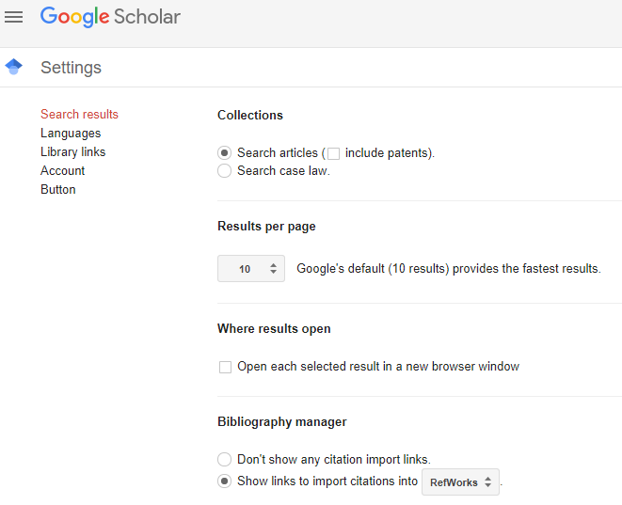
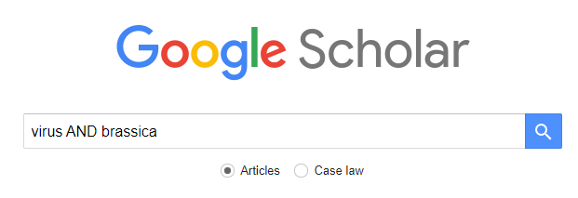
Google Scholar (1)
https://scholar.google.co.uk
Notes:
Configuring Google Scholar for RefWorks
You can configure Google Scholar to link directly to RefWorks.
At the top of the Google Scholar screen, click on the three-bar menu button then click Settings. Scroll down to Bibliography Manager and click on the drop down menu to choose to “Show links to import citations into RefWorks”.
Click “Save”.
Exporting to RefWorks
Google Scholar allows you to export individual references into RefWorks.
You will see a link to “Import into RefWorks” beneath each reference – click on the link. In some browsers, the “Import into RefWorks” isn’t visible – click on the “>>” link to access this option.
You will then be asked if you wish to export to RefWorks. Select Yes, export to the newest version of RefWorks.
RefWorks will open in your browser. If you’re not logged in, you’ll be prompted for your username and password.
Click on Import – you can choose to import into a Folder at this stage or do so at a later stage. Click on OK to view the record in your “last Imported” folder.

Slide 23
Practice using task sheets
Available at https://www.bodleian.ox.ac.uk/ask/workshops/reference-management-workshop-handouts
Sign up for a RefWorks account
Export reference from databases. Choose from:
SOLO
Google Scholar
EBSCO databases (e.g. Historical Abstracts, American History and Life, ATLA for Theology/Religion, Philosophers Index etc)
JSTOR
MLA
Proquest
Web of Science
Adding a reference manually
….or try out a database of your choice

Slide 24
Import
There are 3 ways to import references:
Save to RefWorks plugin
Saved files and import filters
Drag and drop PDFs

Slide 25
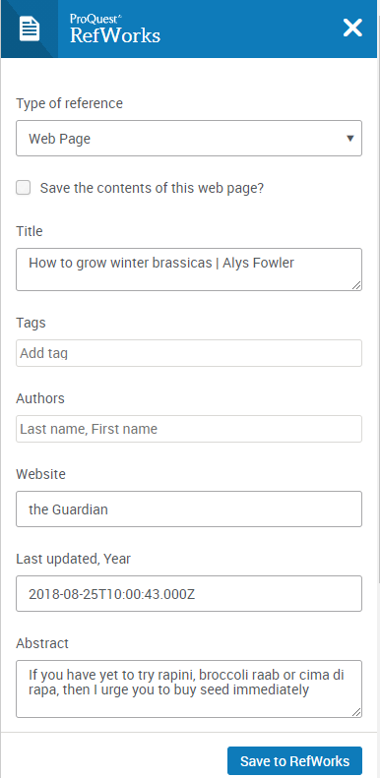
Save to Refworks Plugin
Notes:
You can install a RefWorks plug-in within your web browser
Installing the Save to RefWorks plug-in
From the main RefWorks page, click on the spanner icon from the menu bar at the top of the page.
Click the spanner icon and select ‘Tools’ from the drop down menu.
Click on Install Save to RefWorks
Drag the Save to RefWorks button to your favourites/bookmarks bar as prompted.
The Save to RefWorks plug-in will display differently depending on the browser that you’re using.
ser to add references and full-text from any website. You will need to display your favourites/bookmarks bar in order to do this.
Using the Save to RefWorks plug-in from Firefox, Google Chrome & Microsoft Edge
Log into your RefWorks account.
In a separate tab in your browser, open the website you want to add to RefWorks.
Click on the Save to RefWorks link from your bookmarks/favourites menu below the URL box in your browser.
A RefWorks preview pane will open up on your screen – this may take a little time
This is your opportunity to amend the information or add supplementary details.
Once you’re happy with the information, click on Save to RefWorks.
You can decide to assign to a folder before clicking on Import
You will receive confirmation that the reference has been added to RefWorks.

Slide 26
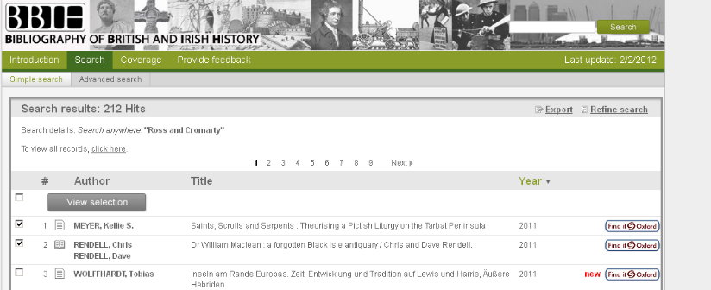
Indirect import from Bibliography of British & Irish History - 1
Indirect import from Bibliography of British and Irish History (BBIH)
1. Select the items you want to save and click on Export.

Slide 27
Indirect import from Bibliography of British & Irish History - 2
Indirect import from Bibliography of British and Irish History (BBIH)
2. Change the file name to something you will remember.
3. Select Download as method of export.
4. Select “.txt – RefWorks tagged format”.
5. Click on export, then save file to computer. Remember to save it to a location that you will be able to find (e.g. Desktop or Downloads folder).

Slide 28
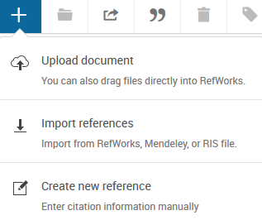
Indirect import from Bibliography of British & Irish History - 3
Indirect import from Bibliography of British and Irish History (BBIH)
6. Click add a reference button
7. Select Import references

Slide 29
Indirect import from Bibliography of British & Irish History - 3
Indirect import from Bibliography of British and Irish History (BBIH)
8. Click Drop file here or select a file from your computer.
9. Select your file.

Slide 30
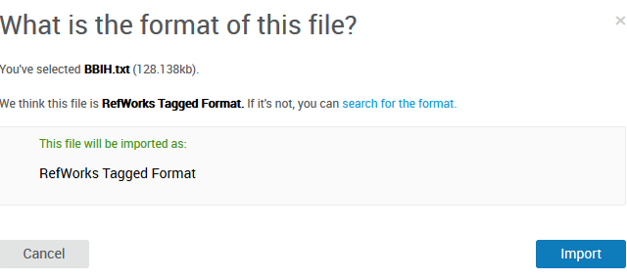
Indirect import from Bibliography of British and Irish History (BBIH)
10. Amend the file format if necessary.
11. Click Import.

Slide 31
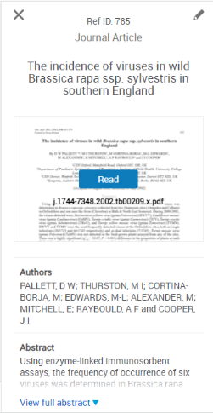
Drag and drop PDFs
Notes:
If you have PDFs of journal articles saved onto your computer, you can add them to your RefWorks account and RefWorks will automatically find matching citation data where available.
Open your file explorer and locate the PDF you want to add to Refworks.
Click on the relevant PDF and drag into the RefWorks page on your browser. Release the file when prompted to ‘Drop files’ here.
The automatic facility within RefWorks will find matching citation data (e.g. bibliographic details such as author, title, publication details) where available.
To verify that the citation is correct, click on the newly added reference.
The reference details will appear in the right-hand preview pane.
Click on the pencil icon if you need to amend the information.

Slide 32
Editing references
You may need to edit references you export from catalogues and databases
Records exported from SOLO, in particular, may need editing
If you do not edit your records this may lead to errors in your bibliographies and citations
Notes:
Now you know how to get references from various catalogues and databases into RefWorks, it is important to learn how to manage and look after them in RefWorks. This is important because, if there are any issues with your references in RefWorks, those errors will come out in your essay or paper when you cite them in Word.
You may find but you need to edit references that you export from catalogues and databases. This is particularly the case for SOLO, which is the University’s resource discovery tool. This is not because the information on SOLO is bad. Quite the opposite. The bibliographic records on SOLO are created using cataloguing rules that ensure consistency in libraries across the world. If there is an author’s name that is very common, for instance John Smith, they will be distinguished by their date of birth and in some cases the date that they died. This helps people navigate and differentiate between people of the same name. But this information can get pulled through to reference in the author field of RefWorks.

Slide 33
Editing records: authors
Authors: additional information such as birth/death dates should be deleted.
Works by multiple authors: Authors may be missing. If so, add authors manually.
Add as: surname, first names (or initials).
Press return to add the names separately.
Notes:
Moving onto the next slide and mentioning again my previous example. Any additional information like birth and death dates should be deleted if they appear in author field of the RefWorks record.
Works that have multiple authors: you may find that the additional authors are missing, so only the first author pulls through. In this case, you will need to add the other names manually. It’s important to note the formatting for entering names. The surname comes first followed by a comma, a space and their first name, or their initials if their first name is not available. You press return or enter on your keyboard to enter the name into the field and the cursor is ready for you to enter the next name.

Slide 34
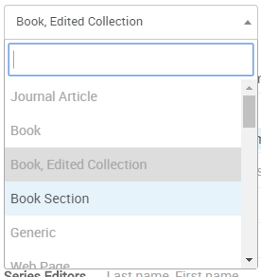
Editing records: edited works
If the item is edited rather than authored, change the reference type from ‘Book’ to ‘Book, Edited Collection’.
If you do not do this, RefWorks may erroneously give the editor as an author or list the book as anonymous.
Notes:
[Demo.]
If you would like to cite an edited book, you need to change the reference type from ‘book’ to ‘book, edited collection’. If you don’t do this, RefWorks may give the editor as the author or even list the book as anonymous. This means the information will come out incorrectly when you cite this item in Word.

Slide 35
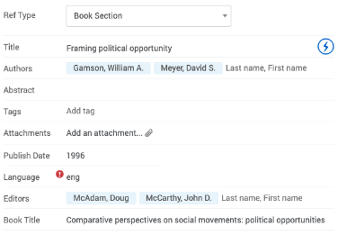
Editing records: edited collections
Citing a chapter in an edited collection: change the reference type to ‘Book Section’.
Author & section title must be entered manually.
You can avoid manually entering editor(s) & book title by cutting and pasting the information.
Chapter details
Book details
Notes:
[Demo.]
If you want to cite a section of a book, like a chapter or introduction, you need to change the reference type to book ‘section’. The book record that you export from a catalogue or database will just have the title and author information for the book as a whole. To be able to cite a section of a book, make sure that you have the editing window open for your reference in RefWorks and change the reference type from ‘book’ to ‘book section’. You will need to enter the author and section title manually for the section that you want to cite.
You will be able to cut and paste the title and editor for the book itself into the correct fields of the RefWorks record, rather than having to type them manually.

Slide 36
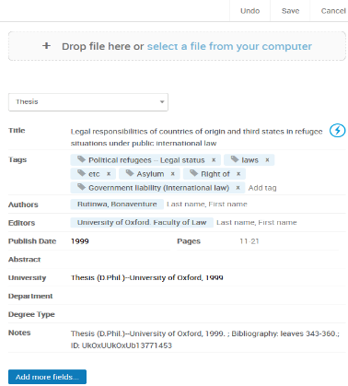
Editing references, attaching documents & adding notes (1)
1. Highlight a
reference and click on edit.
2. Make any changes
needed to the
bibliographical details.
Notes:
[If previous slides have not been demoed, demo now how to edit a record. Stress checking references and editing as needed.]
To edit, click on the reference in the middle of the RefWorks screen. This will bring up a pane on the right hand side with a pencil icon in the top right, which is the edit button. Click this and you will be able to make edits to the record. Make sure you save any edits.

Slide 37
Editing references, attaching documents & adding notes (2)
3. To attach a document, click on Add an attachment & navigate to your saved document or drag & drop the file.
4. To add personal notes click in the notes field.
Notes:
[Demo.]
You can also add documents to your reference in RefWorks. Some people like to do this because it means they have the full-text PDF of the article or book chapter, for instance, sat with the reference in RefWorks. It is not essential that you add full-text documents to your reference in RefWorks if you prefer to store them elsewhere, but the option is available.
To add a document to a reference, make sure that you are in the editing pane for the reference. You will find a button that says ‘add an attachment’. Find the file on your computer and add it to the reference. Alternatively, you can drag and drop the file.
You can also add a personal note to reference in RefWorks. This note won’t appear in Word when you cite the reference, it is just there for you to see in RefWorks. To add a note, again, make sure you are in the editing pane for the reference. You will find a field called ‘notes’. Type in your personal note here and make sure to save the edit.

Slide 38
Organising and de-duplicating your references
Notes:
As well as making sure your references are accurate, it’s a good idea to keep them organised within RefWorks and also to find and remove duplicate entries.

Slide 39
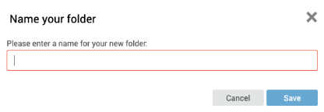
Creating folders (1)
1. Select Add folder under My Folders
2. Enter a name in the Name your Folder box and click Save
Notes:
[Demo.]
You may end up with hundreds or thousands of references and you can use folders to keep them organised. You can organise your references into folders in any way that you like: by module that you’re studying, by journal you are writing, and so on. To add a folder, click ’My folders’ in the column on the left and and ‘add folder’. A pop-up box will appear prompting you to type in the name for your folder. Once you have typed in your folder name, click ‘save’. The new folder will appear under ‘My folders’ on the left in the column.

Slide 40
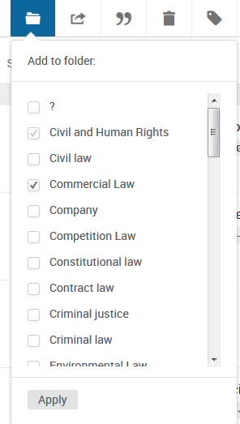
Creating folders (2)
3. Go to Last Imported Folder and select some references.
4. Click on the folder icon
and choose a folder to save your selected references to.
Notes:
[Demo.]
To add references to a folder, tick the box next to the relevant reference or references you want to move. Click ‘assign to folder’, or it may appear as a folder icon, at the top of the page and add the references to the folder you want to.

Slide 41
Creating folders (3)
5. Alternatively, drag and drop the reference into the folder.
Notes:
[Demo.]
Or you can drag and drop them over into the folder in the left-hand column.
You can add references to multiple folders. Sometimes we get asked whether this will duplicate the reference. It does not. The reference will still just exist once, but it will be visible and accessible in multiple folders.

Slide 42
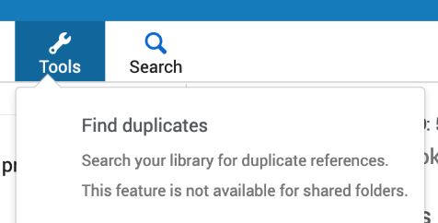
Finding duplicate references (1)
6. To find and remove any duplicates click the ‘Tools’ button
and choose Find duplicates.
Notes:
[Demo.]
Moving on to duplicate references. It’s possible you may end up with duplicate entries for the same reference. This may happen when you export a reference and then a few weeks or a few months later you export it again not realising you’ve done it before. You may export the reference from one database and export it from another database at a later date too. It is important to find and remove duplicate references because there is a chance they will appear multiple times in your bibliography in your Word document, which wouldn’t be good.
To find a duplicate references, click the ‘tools’ button at the top of the page, or it may be a cog icon. Click ‘find duplicates’.

Slide 43
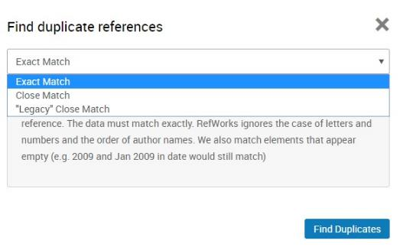
Finding duplicate references (2)
7. Decide whether to find duplicates in all references or in a single folder
8. Choose Exact match for exact duplicate references or Close match for similar duplicate references. “Legacy” close match uses an algorithm from the previous version of RefWorks, which works best for English surnames and short titles.
Notes:
[Demo.]
A pop-up box will appear. You have a few options. You can search for an exact match, a close match, or a legacy close match.
An exact match is what it says. It will find references where every single detail is exactly the same.
A close match is where the references are very similar and RefWorks thinks they are most likely duplicates.
Legacy close match: I haven’t used this one very much other than to test out for teaching this session. If you click on it, it explains what it is. It uses an algorithm for the previous version of RefWorks. It says it works best for English surnames and short titles. I tend to look for a close matches but you may like to try out legacy close match.

Slide 44
Practice using task sheets
Available at https://www.bodleian.ox.ac.uk/ask/workshops/reference-management-workshop-handouts
Add and use the ‘Save to RefWorks’ browser plugin
Add PDFs via ‘drag and drop’
Import references using text files( from the Bibliography of British and Irish History)
Editing a reference
Dealing with books (edited works and collections)
Using folders
Finding duplicates

Slide 45
Inserting citations, footnotes and creating bibliographies

Slide 46
The plug in – to add citations to word processed documents
Word 2016/2017 for Mac and Windows
Use RefWorks Citation Manager
Download from Word store (Word > Insert > Word store > search for RefWorks Citation Manager)
NB. for earlier versions prior to Word 2016
Use the Write N Cite plug-in from RefWorks
Log in to RefWorks and download the plug-in from Tools / Cite…

Slide 47
Refworks citation manager (Word 2016/2017 onwards)

Slide 48
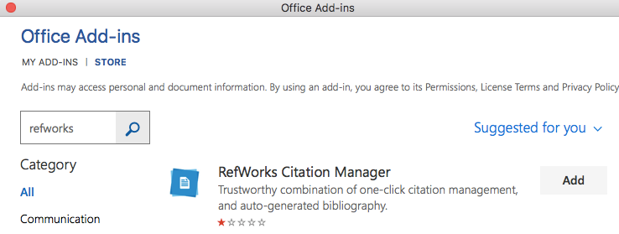
Adding Citation Manager Plugin
In Word choose Insert / Store
In the Store search for RefWorks and then choose Add

Slide 49
Logging in to Citation Manager
The Citation Manager opens on the right of the screen. Log in with your Refworks username and password

Slide 50
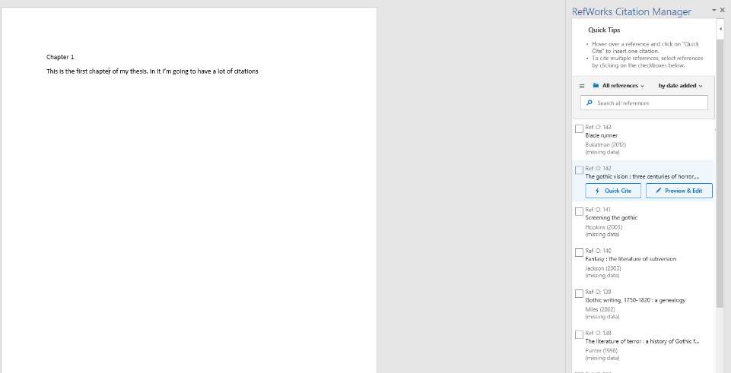
Adding citations
1. Choose a citation style by clicking the menu icon
2. Place your cursor at the point where you want your citation to appear
3. Find citations in your library by browsing folders…
….or by entering keywords in the search box
4. To insert a citation click " Cite This…
…to edit a citation (e.g. to add a page number) choose Edit this. Note: if there is an error in the citation (e.g. spelling mistake) you need to correct this in RefWorks

Slide 51
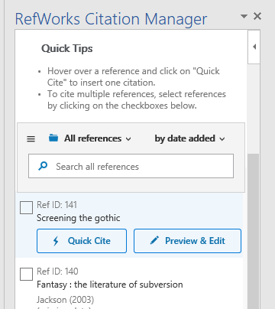
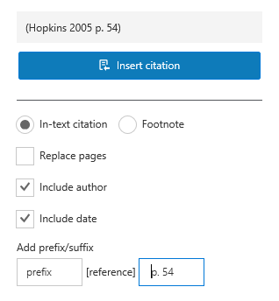
Editing a citation (e.g. adding page numbers)
A preview of the citation appears here
Click Edit this
If you use a suffix, don’t forget to insert a space before your text (or a space after a prefix). Otherwise your suffix/prefix will join on to the citation without a space

Slide 52
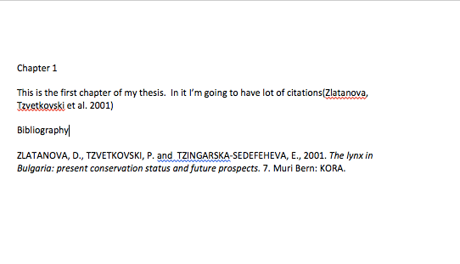
In-text citations
Citation manager inserts the citation in the text
And adds it to a bibliography at the bottom of the document

Slide 53
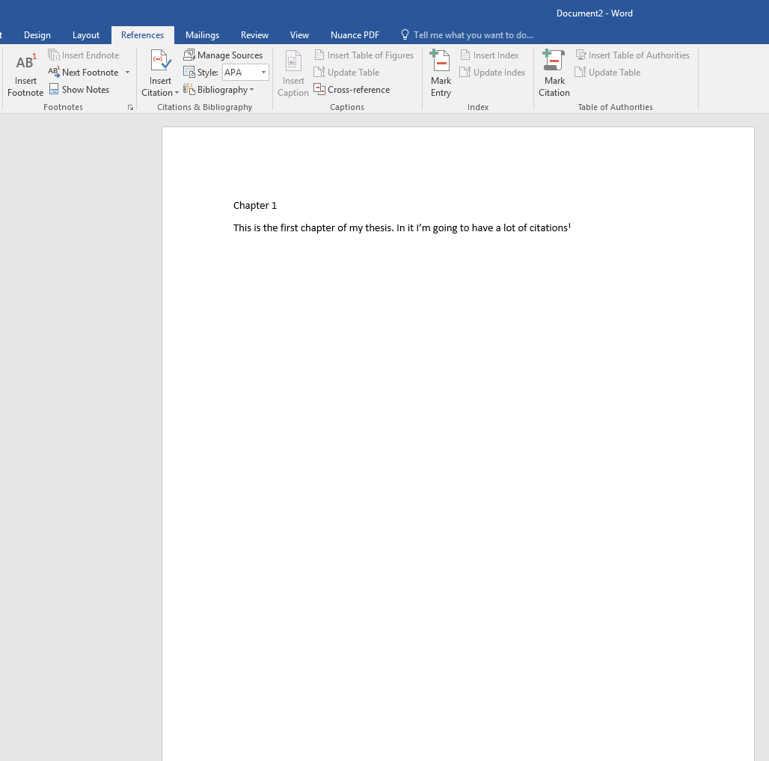
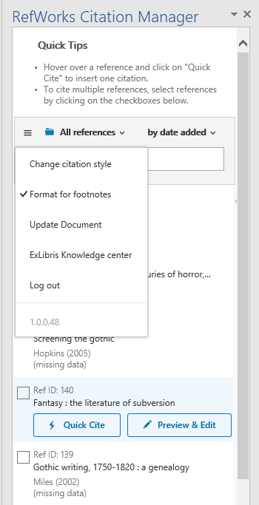
Using footnotes
1. Choose an appropriate citation style
2. Select Format for footnotes
3. Put the cursor in the appropriate place in the text
4. Choose References / Insert Footnote (in Word)
5. Choose " Cite This from the citation manager

Slide 54
Changing Citation Style
Click on the ‘hamburger‘ menu
Then click on ‘Citation Style’

Slide 55
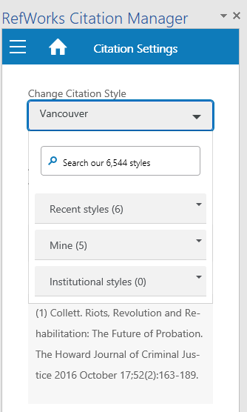
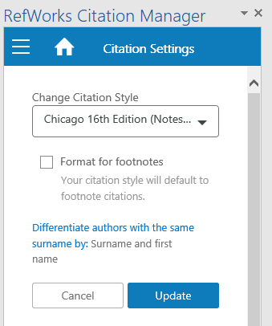
Changing Citation Style (2)
The next screen will give you the option to: Search Styles Select from Recent Styles
Choose from your favourites (Mine)
Click Update

Slide 56
Creating bibliographies in refworks

Slide 57
Creating a bibliography of selected items in RefWorks (without Citation Manager) (1)
You can create a bibliography or list of items without using Citation Manager
Useful if you want to create a bibliography of everything you have read (rather than everything you have cited), or a bibliography from separate collections such as Primary Sources
Go to RefWorks and click ” - Create Bibliography
Notes:
NB Using CM will put in a bibliography as you go.

Slide 58
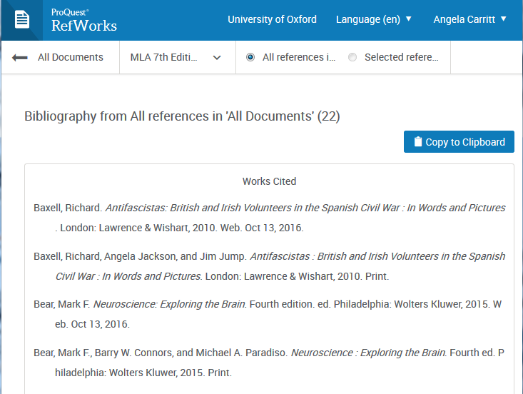
Creating a bibliography of selected items in RefWorks (without Citation Manager) (2)
A bibliography will appear on screen. Use the options along the top to change citation style or to select a different set of references
To copy the bibliography into a , click ’Copy to Clipboard’ and then paste in the usual way.

Slide 59
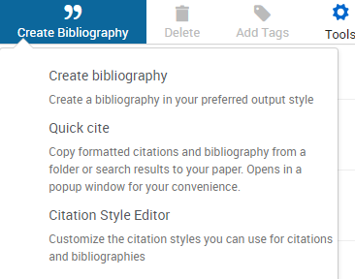
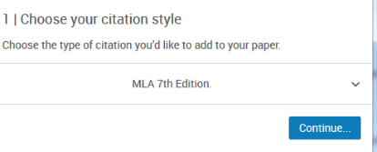
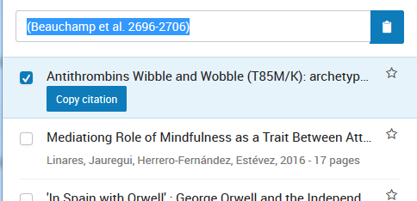
Using QuickCite
Citation Manager is only available for MS Word and Google Doc. To add citations to other word processors, use Quick Cite
1. Choose Quick Cite
2. Choose a citation style
3. Find a reference and click Copy Citation. Then paste it into your word processor
4. When you have finished click “Continue to Bibliography”. RefWorks will create a bibliography that you can paste into your word processor

Slide 60
Write n Cite (word versions prior to 2016)

Slide 61
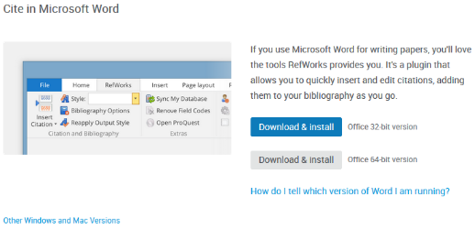
Downloading & installing the plugin
1. Choose followed by tools
2. Choose ‘Cite in Microsoft Word’

Slide 62
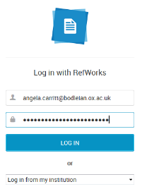
Logging into the RefWorks
plugin for Word
Open Word, once you have installed the plugin you will see the menu option ‘RefWorks’ in your ribbon. If this doesn’t appear click on View – Toolbars - Proquest
To access your RefWorks account click ‘Log in’ and enter your RefWorks username and password

Slide 63
Adding citation styles to WnC (1)
WnC comes with a small number of citation styles installed
To add citation styles, you need to first use the styles in RefWorks to create a bibliography (even if you don’t want a bibliography)
1. Click ” - Create Bibliography
Notes:
Demo

Slide 64
Adding citation styles to WnC (2)
2. A bibliography will appear on screen. Choose the citation style you want to add to WnC from the style menu
3. Your chosen citation style will now appear in the styles drop down in WnC when you next Log in to Word. Choose “Sync My Database” if it doesn’t appear to synchronise with your online RefWorks Library.

Slide 65
Adding a citation in Word (1)
Choose RefWorks from the ribbon and make sure you are logged in to RefWorks
Choose a citation style from the drop down menu
Notes:
Choose a referencing style from the drop down
Demo

Slide 66
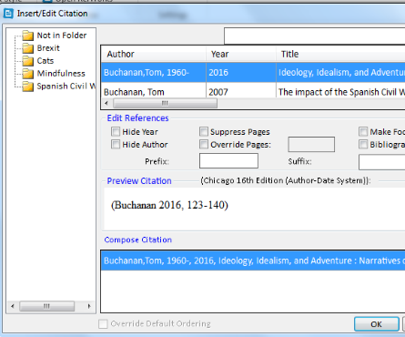
Adding a citation (2)
Place your cursor where the citation is to be inserted and click Insert citation > Insert new
This will open a dialogue box. Find the relevant citation(s) by browsing folders or by searching.
Click the relevant citation once to select (it will appear in the box at the bottom of the dialogue box).
Click OK.

Slide 67
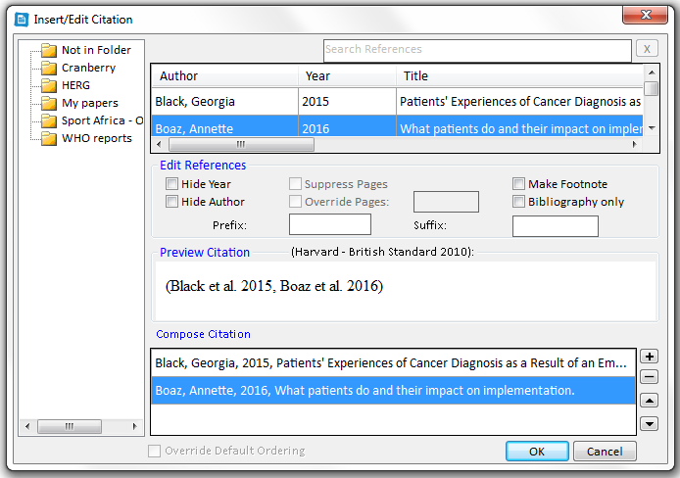
Adding multiple citations
Select the first reference as outlined previously – do not click on OK
Click the + option next to the bottom display box.
Select the second reference and repeat for subsequent references.
Click on OK to insert all references.

Slide 68
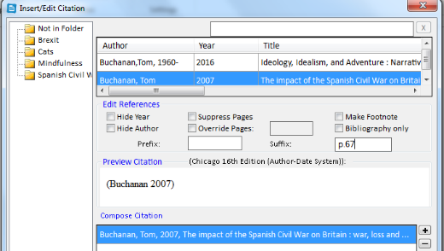
Adding page numbers to a citation
Select the reference by clicking once. It should appear in the box at the bottom of the screen.
Use the options in the centre to insert a page number (you will need to type a space first to ensure there is a gap between the end of citation and the page number)
This section can also be used to hide year/author etc.

Slide 69
Creating a bibliography using WnC
To create a bibliography of items cited, in the RefWorks tab click Bibliography Options and choose Insert Bibliography.
To remove click Bibliography Options – Remove Bibliography.
To change output style – choose a new style from the drop down menu.

Slide 70
RefWorks in Google Docs

Slide 71
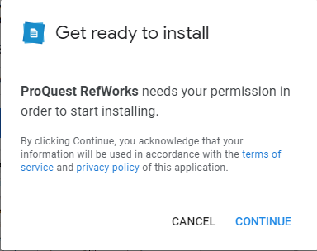
Adding RefWorks to Google Docs
Open a blank document, and select ‘Add-ons’, ‘Get Add-ons’ and search for ‘ProQuest RefWorks’. Click ‘Install’.
You’ll need to accept some permissions and choose your account to continue.

Slide 72
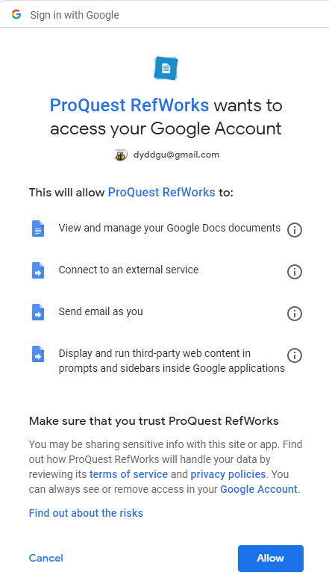
You will then find RefWorks under the ‘Add-ons’ tab in Google Docs

Slide 73
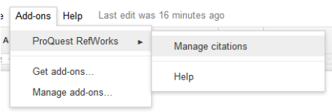
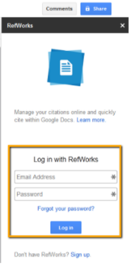
When you’re ready to insert your first citation, select ‘Add-ons’, ‘ProQuest RefWorks’, then ‘Manage Citations’.
You will be asked to log in to your RefWorks account the first time.

Slide 74
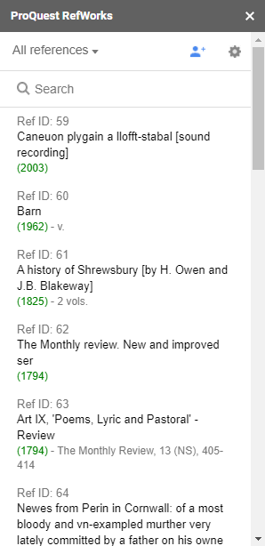
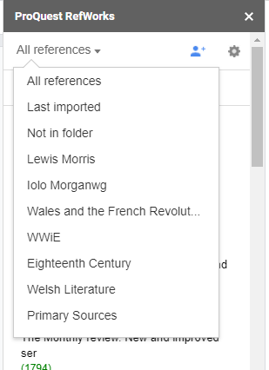
The pane will change to show All References:
You can use the search box to search for references, or find individual folders by clicking on the arrow next to All References.

Slide 75
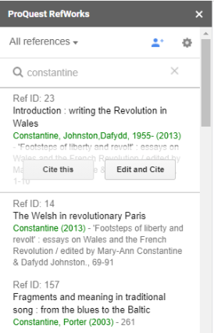
You can now go ahead and type your paper; when you’re ready to insert a citation, search for the reference in the Citation Manager Pane, then either click ‘Cite’ or ‘Edit and Cite’ to add page numbers, hide the author name or publication year:
Citations will then appear in your work, along with an instant bibliography.
Citations appear in your last used style – click the cog icon to change this.

Slide 76
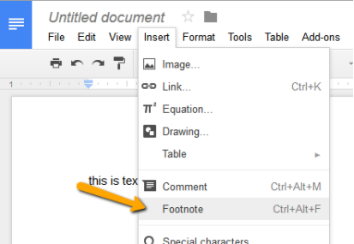
If your citation style supports footnotes, use ‘Insert – footnote’ to add a footnote:

Slide 77
To change your citation style, click on the cog icon and select ‘Change Citation Style’.
You can then search for the citation style you need and select from the resulting list. Click Update.

Slide 78
For a more in-depth look at how to use RefWorks with Google Docs, see the ProQuest RefWorks Libguide:
https://knowledge.exlibrisgroup.com/RefWorks/Product_Documentation/RefWorks_User_Guide/0500_RefWorks_Add-ons%3A_Connecting_Your_Browser,_Microsoft_Word,_and_Google_Docs_to_RefWorks/003_RefWorks_for_Google_Docs

Slide 79
Help with Refworks

Slide 80
Help with RefWorks
Use Help from the RefWorks menu
Report any problems or make requests for new filters to refworks.support@exlibrisgroup.com
Local help is available by emailing reference-management@bodleian.ox.ac.uk
FAQS are at https://libguides.bodleian.ox.ac.uk/reference-management/RefWorks-FAQs

Slide 81
Questions?

Slide 82
Practice using task sheets
Available at https://www.bodleian.ox.ac.uk/ask/workshops/reference-management-workshop-handouts
Using Citation Manager to insert citations and create a bibliography
Create a bibliography in RefWorks
Notes:
Installing RefWorks word processor plug ins for MS Word and Google Docs (last updated October 2016)
Using 'Write n Cite' to insert citations/footnotes and create a bibliography of cited references (last updated October 2016)
Using Quick Cite (this can be used to add citations to documents without installing 'Write n Cite') (last updated October 2016)
Creating a bibliography (last updated October 2016)

