Slide 1

Introduction to Searching
How to find literature on a topic in medicine and health care
Matthew Henry & Kat Steiner
Bodleian Health Care Libraries
Photo by Vlada Karpovich from Pexels
Notes:
MH Slides 1-8

Slide 2
Why do a literature review?
Make yourself familiar with a topic area
Answer a specific question
Set your study in context
Map gaps and patterns
Search, select, evaluate, synthesize, report…

Slide 3
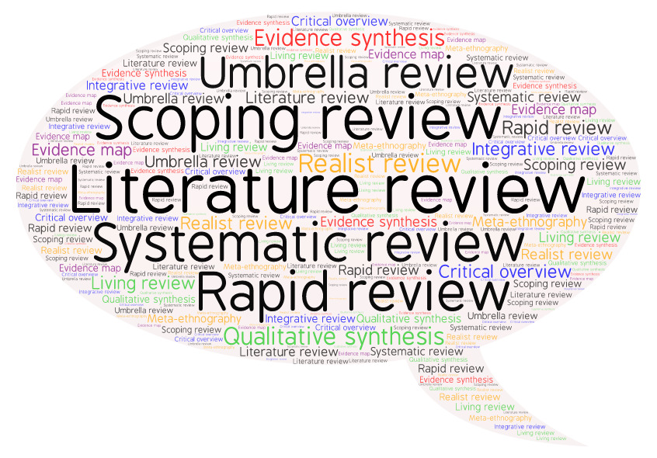
Types of review
Read more: Booth & Grant, 2009

Slide 4
Search process
What is your topic / research question?
What research will help you answer it?
Where will you find it?
How will you search to find it?
How will you keep up-to-date with new research?
How will you organize what you find?
How will you write up the search process?

Slide 5
What’s your topic?
Background questions
  What are electronic cigarettes?
  How many adults in the UK use electronic cigarettes?
  How are electronic cigarettes regulated in the UK
Foreground questions
  Are electronic cigarettes effective in promoting smoking cessation?
  Is vaping safe for pregnant women?

Slide 6
What type of publication?
Background questions
  Books
  Reports
  Official publications
  Websites
Foreground questions
  Journal articles
  Preprints
  Conference abstracts
  Study protocols
  Theses/dissertations
  Reports
  Official publications
  Websites

Slide 7
Where to search?
Library catalogue
  Books, online journals, theses, databases…
Bibliographic databases
  Articles
  Books and chapters, conference abstracts, theses, reports – in some but not all databases
Online repositories
  Study protocols and preprints
Websites
  Anything and “everything”…

Slide 8
Background question: How to search?
Library catalogue
  Searching SOLO: Top tips
Web searching
  Academic web – Google Scholar, LENS.org
  Search engines – Google, DuckDuckGo
  Individual websites – search or browse

Slide 9
Break 1

Slide 10
Foreground question: How to search?
Structured search
Keywords for each search concept
Combine with AND/OR
Apply limits
Search across multiple databases
Snowballing
Citation tracking
  Forward
  Backward
Related articles
Sibling studies
Grey literature searching
Notes:
KS slides 10-20

Slide 11
Structured search: search concepts (1)
In long-term smokers, can electronic cigarettes be used as an effective smoking cessation technique?

Slide 12
Structured search: search concepts (2)
In long-term smokers, can electronic cigarettes be used as an effective smoking cessation technique?

Slide 13
Structured search: PICO (1)
Population, Patient, Problem
I(E)Intervention, Exposure
Comparator, control
Outcome
Study design
In long-term smokers, can electronic cigarettes be used as an effective smoking cessation technique?

Slide 14
Structured search: PICO (2)
P Long-term smokers
I(E) Electronic cigarettes
C N/A
O Cessation
S Systematic reviews/RCTs
In long-term smokers, can electronic cigarettes be used as an effective smoking cessation technique?

Slide 15
Structured search: search terms
Concept 1 (Population)
Smokers, smoking, tobacco use…
Concept 2 (Intervention)
Electronic cigarettes, e-cigarettes, vaping, Juul…
Concept 3 (Outcome)
Cessation, quit, stop, give up
Concept 4 (Study type)
Systematic Review, RCT

Slide 16



Structured search: combining terms (1)
AND | smoking AND cessation |  | Narrows search
OR | cessation OR stop |  | Broadens search
NOT | adults NOT children |  | Narrows search

Slide 17
Structured search: combining terms (2)
(smoking OR smokers OR tobacco use) AND (electronic cigarettes OR e-cigarettes OR vaping OR juul) AND (cessation OR quit OR stop OR give up)
AND = Combining different search concepts, narrows search
OR = Combining synonyms for the same concept, broadens search

Slide 18
Structured search: shortcuts
(smok* OR “tobacco use*”) AND (“electronic cigarette*” OR e-cig* OR vaping OR juul) AND (cessation OR quit* OR stop* OR “give up”)
* = truncation
“” = phrase searching

Slide 19
Structured search: applying limits
(smok* OR “tobacco use*”) AND (“electronic cigarette*” OR e-cig* OR vaping OR juul) AND (cessation OR quit* OR stop* OR “give up”)
Filter by date, language, publication type (e.g. systematic review, RCT), age groups…

Slide 20
Structured search: subject search
On Medline, search using Medical Subject Headings(MeSH)
Articles are tagged with keywords from a structured vocabulary
A search for these keywords retrieves articles on the topic
Equivalent subject / thesaurus searching available on many databases but not all

Slide 21
Structured search: databases
Bibliographic databases
  CINAHL
  Embase
  Global Health
  Medline
  Web of Science…
Full list on Databases A-Z - Subject – Medical Sciences

Slide 22
Break 2

Slide 23
Foreground question: How to search?
Structured search
Keywords for each search concept
Combine with AND/OR
Apply limits
Search across multiple databases
Snowballing
Citation tracking
  Forward
  Backward
Related articles
Grey literature searching
Notes:
MH slides 22-25

Slide 24
Snowballing: Why do it?
Finding “missing” research
  Limited scope of databases – discipline, research type…
Best use of time
  Broad topics can retrieve a large volume of results
  Focused search, plus snowballing can be more efficient

Slide 25
Snowballing: techniques (1)
Citation tracking
  Forward
  Backward
Related articles
Grey literature searching
Beware of getting trapped in a bubble

Slide 26
Snowballing: techniques (2)
Citation tracking
  Google Scholar, LENS.org, Scopus, Web of Science
Related articles
  Google Scholar, LENS.org, PubMed
Author linking in databases
Searching for study IDs
Author/organizational web-sites

Slide 27
Snowballing: techniques (3)
Grey literature searching
Web searching
  Google, DuckDuckGo
Specialist resources
  Conference abstracts – conference web-sites
  Guidelines – TRIP, NICE guidance
  Reports – organizational websites
  Preprints – medRxiv, bioRxiv, Europe PMC
  Theses – EThOS, Proquest Dissertations & Theses
  Trial protocols – ClinicalTrials.gov, WHO ICTRP
Notes:
KS 26-end

Slide 28
Managing and organizing references
Reference management software
  Endnote and RefWorks (OU subscription)
  Zotero (Free)
Review management software
  Covidence and EPPI-Reviewer (Subscription)
  Rayyan and SR-Accelerator (Free)
SR Toolbox

Slide 29
Keeping up-to-date
Once you’ve run your searches you might want to be notified of new research on your topic
Email alerts
RSS feeds
Journal TOCs
Twitter

Slide 30
Search process: Note taking
At some point, you’ll write up your review. To report the search accurately keep notes on:
Search terms used – full search strategy for each database
Limits applied
Databases & web-sites searched
Date of search
Snowballing methods used

Slide 31

Search process: questions
Contact us
hcl-enquiries@bodleian.ox.ac.uk
LibGuides
  Systematic Reviews
  Medical Researchers: Research Resources
Resource list
This image by Unknown Author is licensed under CC BY

