Slide 1

The Bodleian Libraries and the Social Science Library:
Financial Economics (Masters) Induction
John Southall, Subject Consultant – Economics john.southall@Bodleian.ox.ac.uk

Slide 2
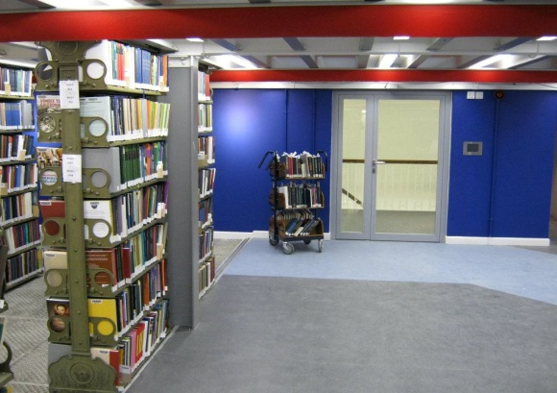
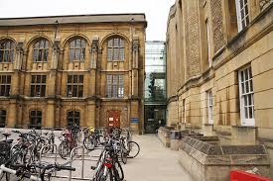
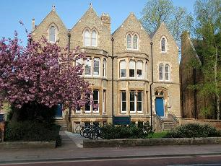

The Bodleian Library Service offers:
30 libraries including
Central Bodleian reading rooms, Social Science, Law, Anthropology, Education, Business, Philosophy & Theology, Latin American Studies, Radcliffe Science, etc.
  www.bodleian.ox.ac.uk/libraries
81,000 e-journals
1.065 million e-books
1,350 databases
12 million print volumes
1,000 items added daily to the collections
4,000 study spaces
500+ computers and wireless network

Slide 3

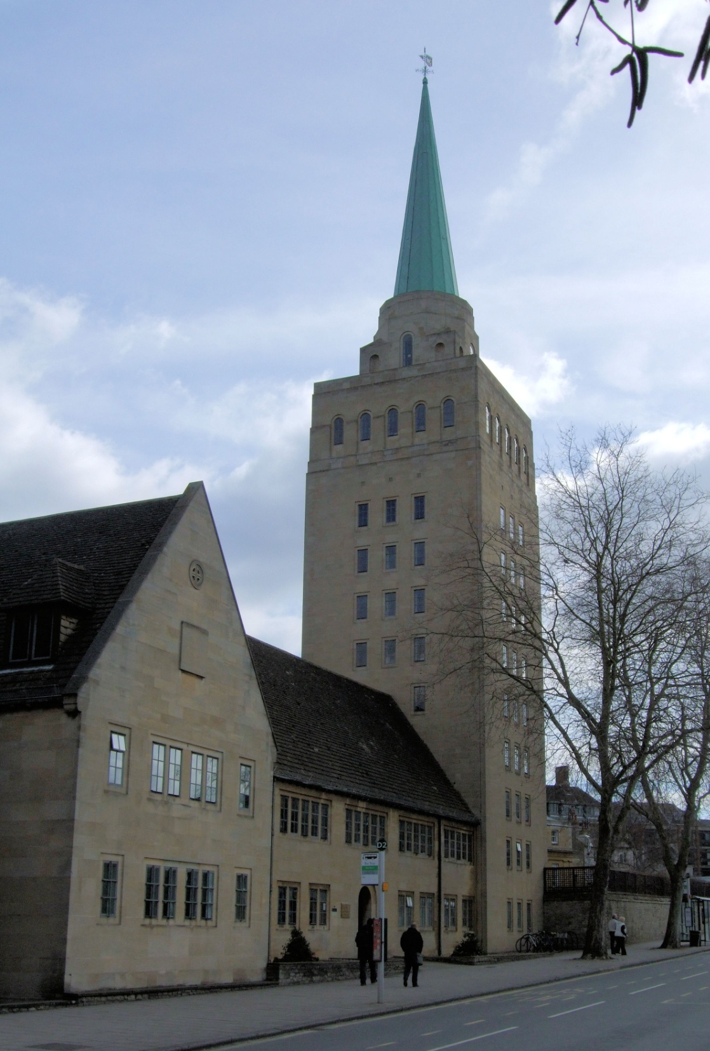
College Libraries
Legal Deposit

Slide 4
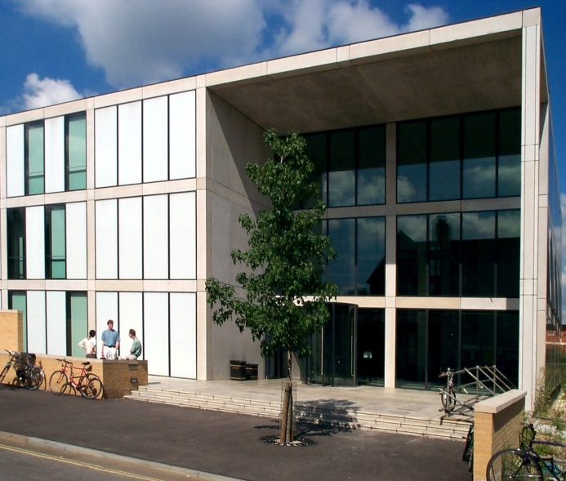
The Bodleian Social Science Library
Opening hours
Term (Wks 0-9)
Mon – Fri
09:00 – 22:00
Saturday
10:00 - 18:00
Sunday
11:00 – 19:00
www.bodleian.ox.ac.uk/ssl

Slide 5

SSL Services and Help
- Reading rooms - Bodleian stack requests - Enquiry services &
friendly staff - Self issue desks - Graduate study rooms - Study
carrels – Bookable discussion rooms - Training courses -
Computers and wireless access - Printing, copying & scanning -
Buy stationery - Free spiral binding - Subject Consultant
appointments

Slide 6



What can I borrow??
  30/40 books, renew up to 7 times
  Watch out for fines! … per day
  20p normal
  £1.00 Short Loan
  Borrowing suspended at £10
7 days/ 1 month
SHORT
LOAN
2 days
confined

Slide 7

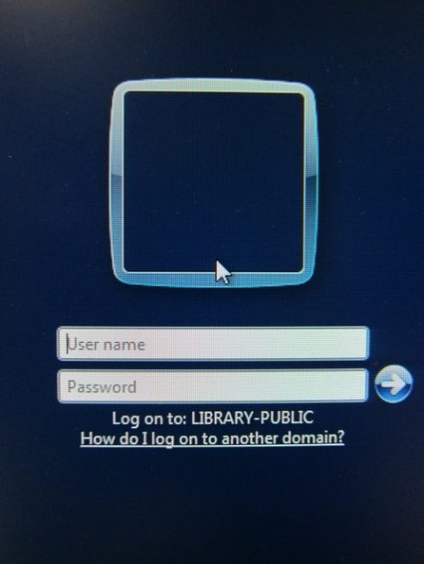
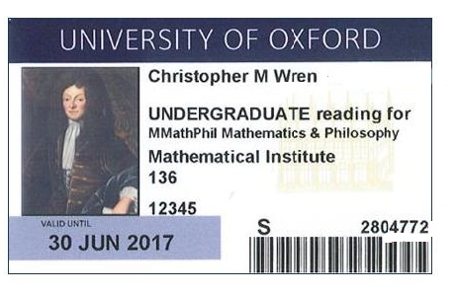
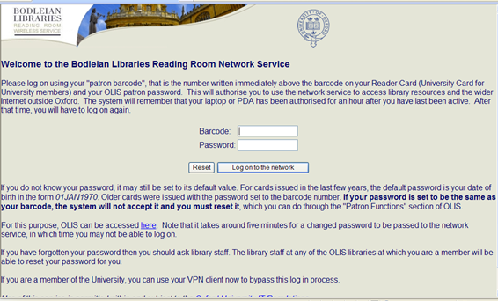
Connecting to Library services
Your username is the
7-digit number on your University card.
Your default password is your DOB (e.g. 01JAN1990).
You need to reset your password @ https://register.bodleian.ox.ac.uk/
Used to connect to Reader PCs and wireless network

Slide 8


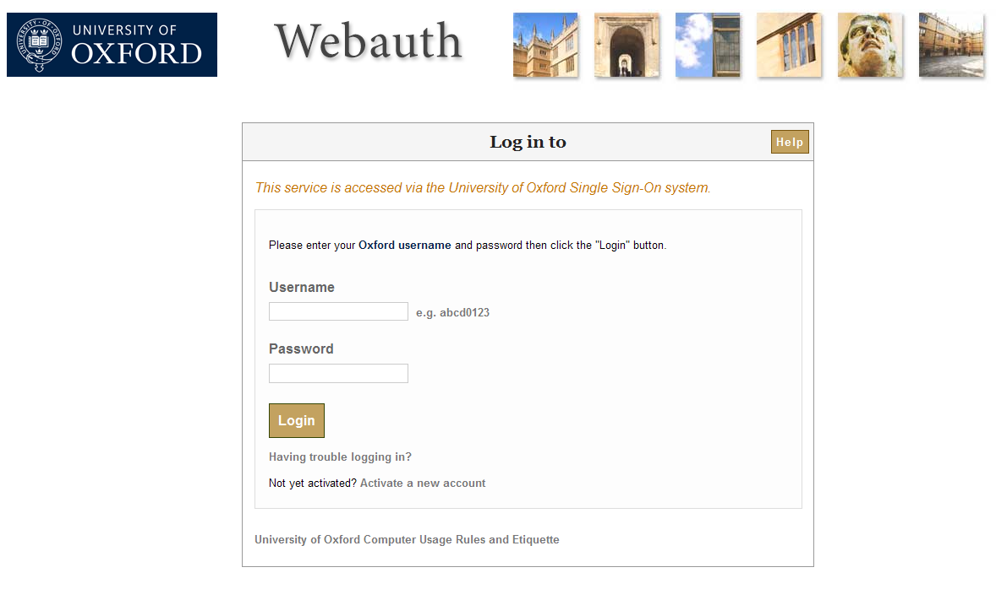
Oxford Single Sign On
Use your Single Sign On (SSO)(issued by OUCS, IT Services) to login to SOLO
(the library catalogue) and MyAccount and to access online resources off-campus
Remember to logout when using public access PCs

Slide 9
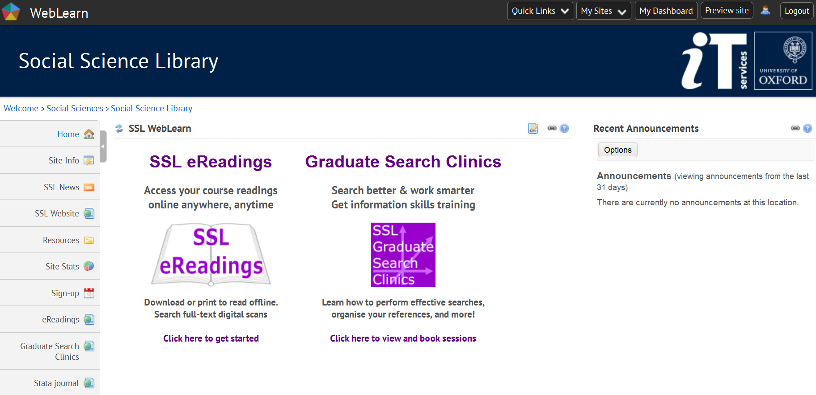
Use SSO for Weblearn https://weblearn.ox.ac.uk/
Notes:
You will also need your SSO to access Weblearn services. Weblearn is the university’s virtual learning environment and the SSL has a page listed within the Social Sciences Division part of Weblearn Two library initiatives of interest include links to future courses and the SSL eReadings service.

Slide 10



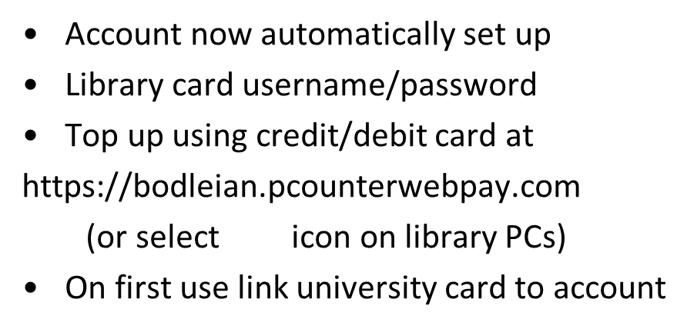
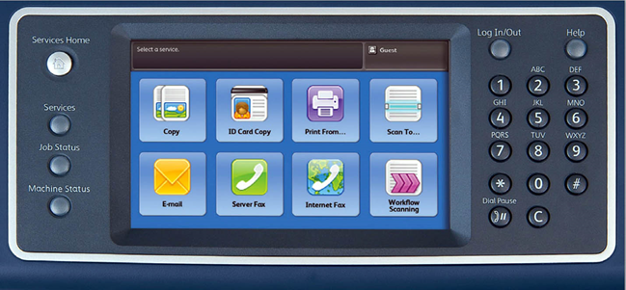
6p A4 b/w
9p double-sided
20p A4 colour
2p scan
DON’T FORGET TO LOG OUT!
Notes:
10
The costs are currently 7p per A4 black and white sheet and 45p for a colour one.
The system is due to change probably at the beginning of next term when you will be able to use your university card instead and top up online so it would be a good idea not to put too much cash on the photocopy cards at the moment.
Just a reminder before we move on that you do need to be aware of copyright rules. If such things excite you there is a poster in the photocopy room giving you the lowdown in detail but basically the rule is that you may only copy, scan or download up to 5% or a chapter of a book - whichever is greater and similarly up to 5% or a single article of a journal.

Slide 11

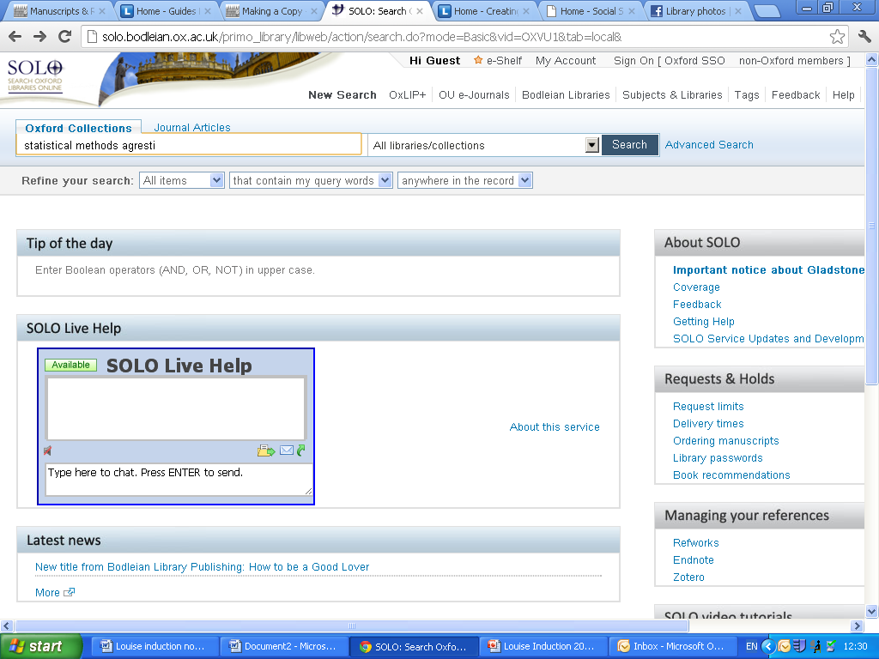
Search for
Books and e-books
Journals and e-
journals
Databases
Digital collections
Request
Place holds
(reservations)
Make stack requests
Manage your account using My Account (SSO) to:
Renew your loans
Check your loans
history
Check for fines
Save and export
references via your
e-shelf
http://solo.bodleian.ox.ac.uk

Slide 12
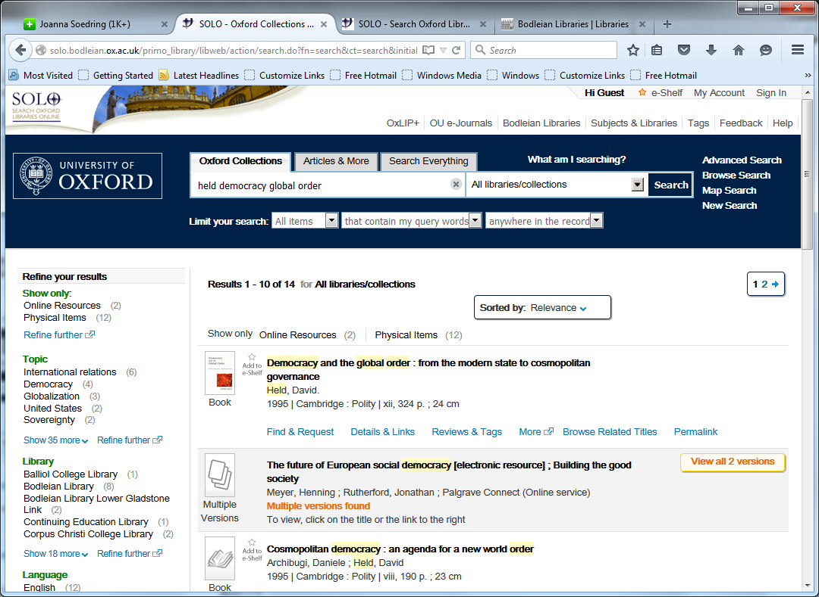

Search tabs
Sign in to place requests and check your account
Click to see multiple copies/versions
Click “Find and Request” to see which libraries hold print copies and their status
Refine your search

Slide 13
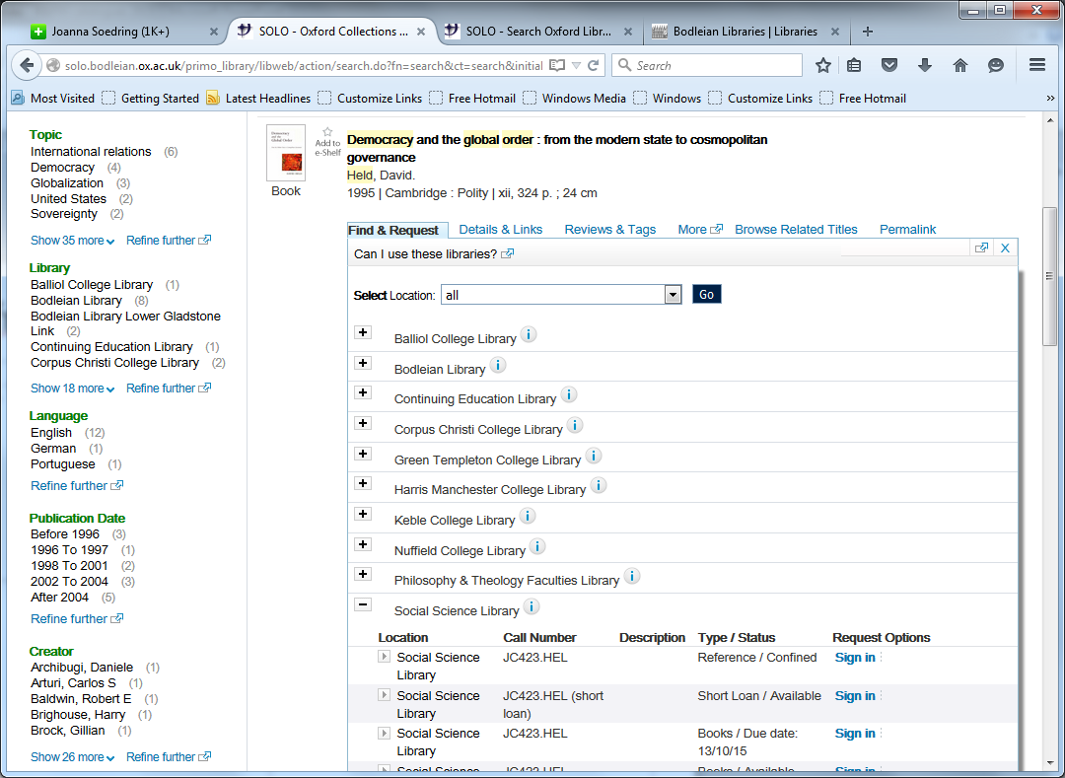
Check the status
  Available = on the shelf and can be borrowed
  (Type: Books = Normal loan, Short loan = 2 days)
  Date (e.g. 13/11/16) = on loan until this date
  Confined = Library reference use only
  Closed stack = Hold request to reading room (reference use only)

Slide 14
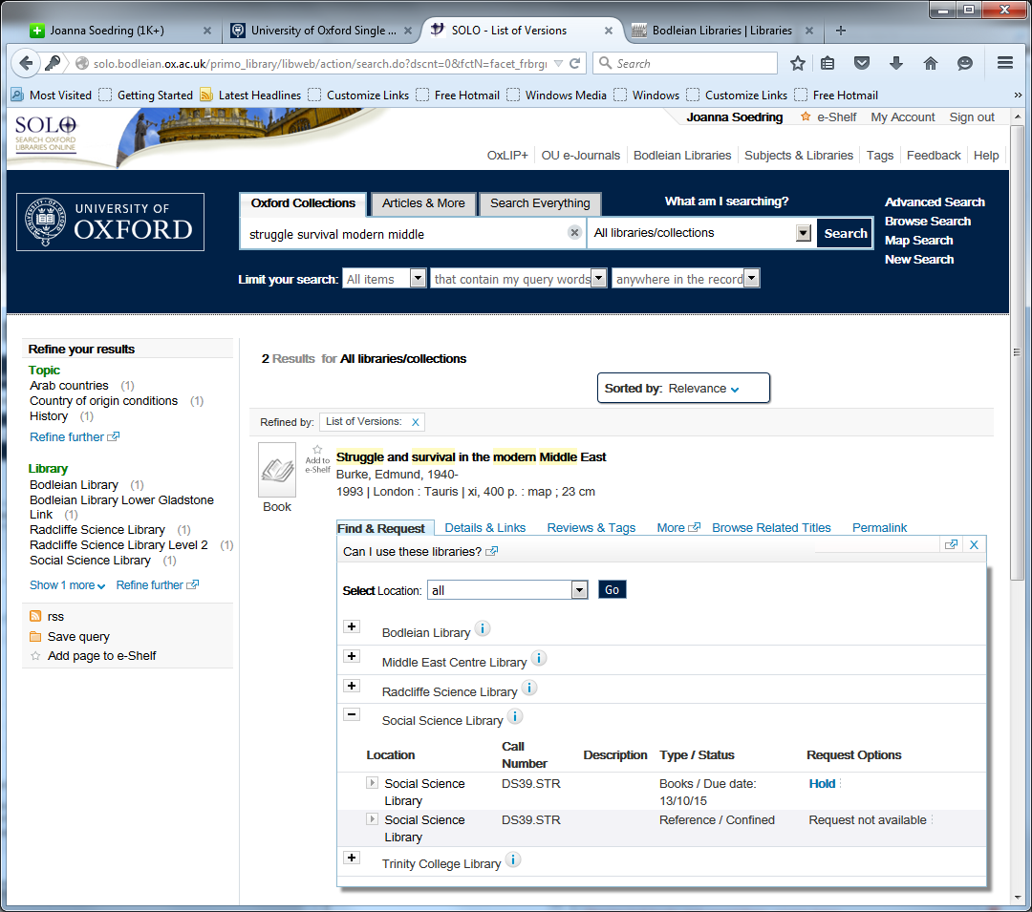

Holds (reservations) - Request via SOLO.
Only when all copies of an item are on loan from a library.
Email notification when books have arrived.

Slide 15
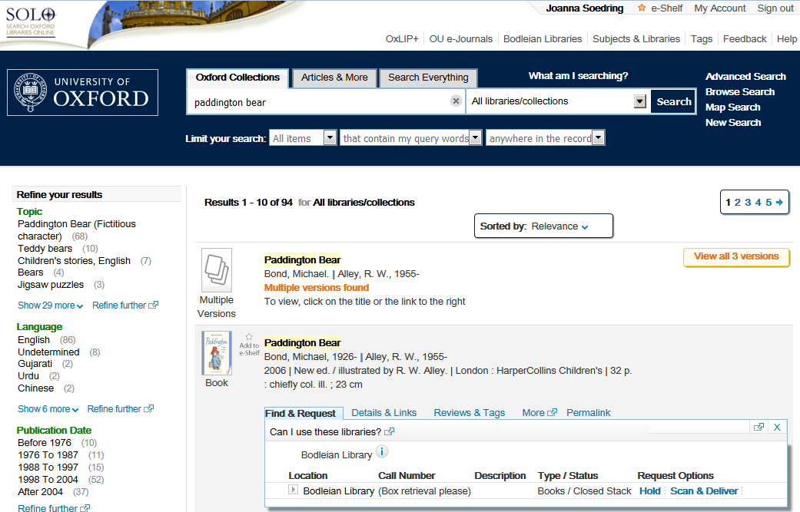
Scan and Deliver service.
1 chapter or 1 article £4.75.
Holds (Stack requests) –
Request via SOLO, 10 items at a time. Read in the library.

Slide 16
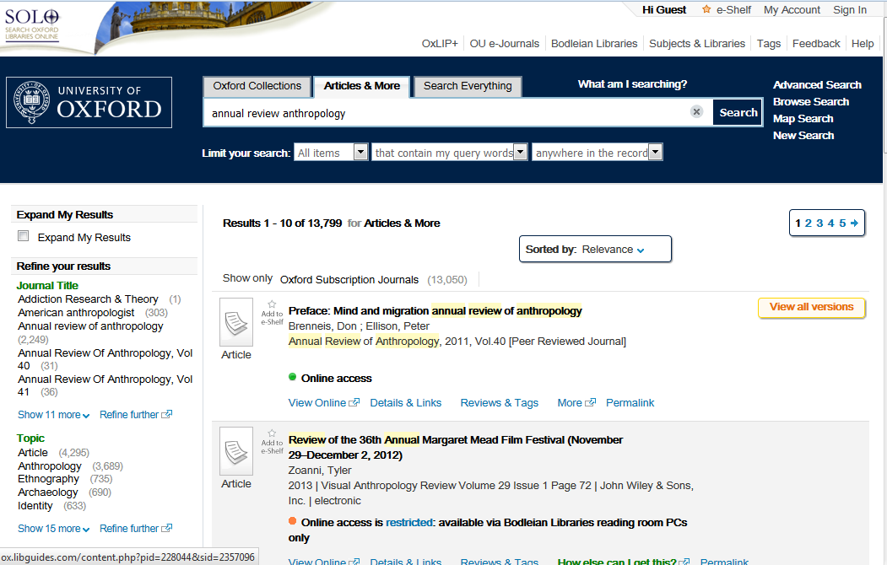
Articles & More tab

Slide 17
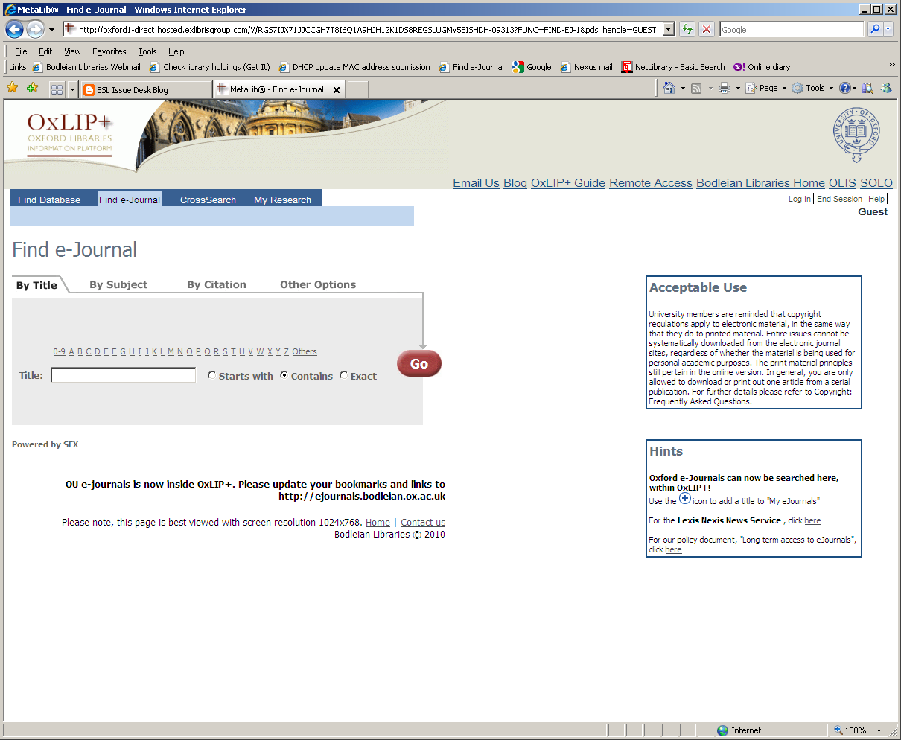
http://ejournals.bodleian.ox.ac.uk

Slide 18
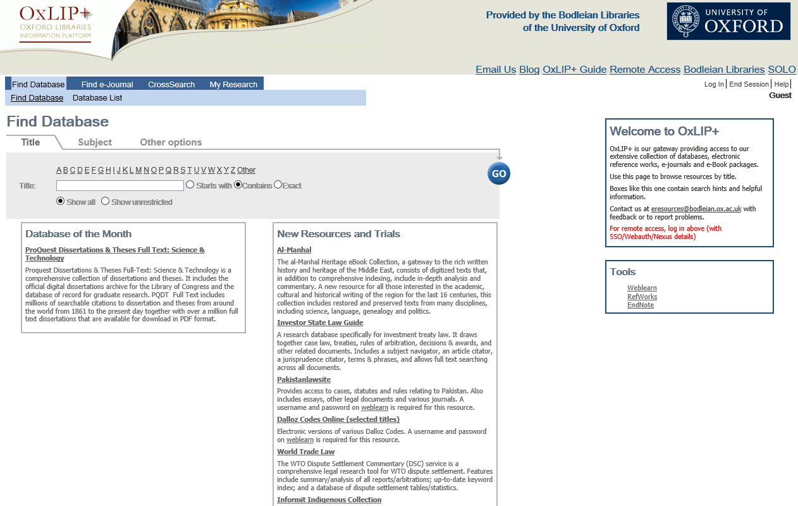
OxLIP+ (link from SOLO)
http://oxlip-plus.bodleian.ox.ac.uk
Notes:
OxLIP+ Platform for databases of bibliographic records (for in-depth literature searching) – a link from SOLO front page
You can check which databases are most appropriate for your subject, by clicking on the Subject tab
You will use the database to carry out your literature searches when the time comes to prepare for your dissertation – look out for training courses if you’d like some guidance.

Slide 19
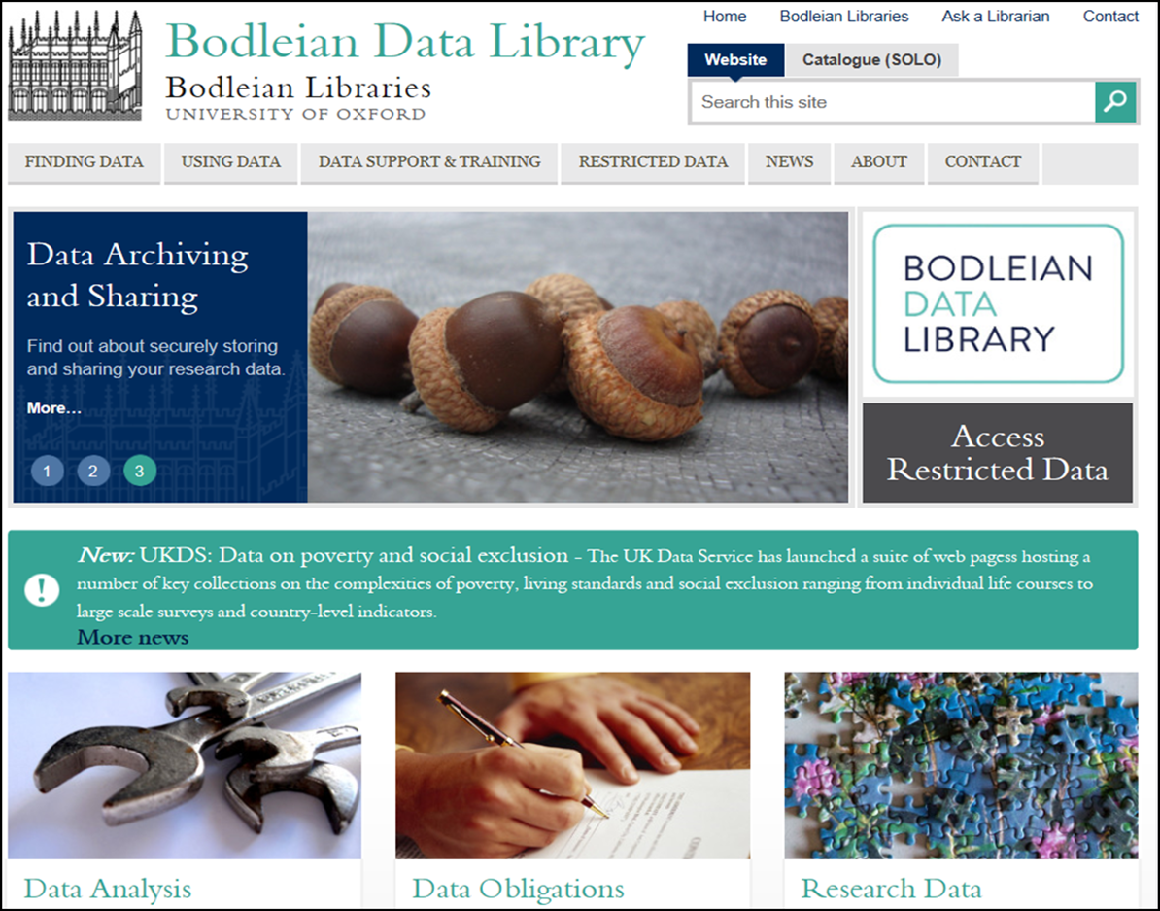
www.bodleian.ox.ac.uk/data

Slide 20


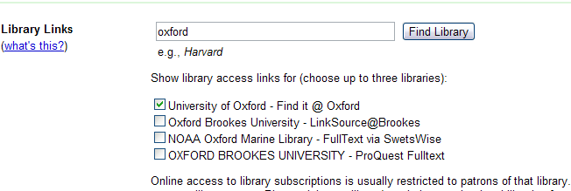
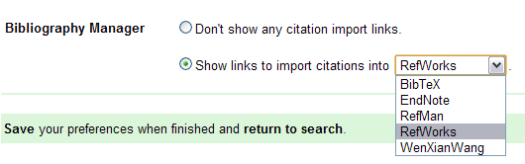
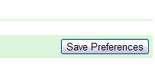
Google Scholar Preferences

Slide 21
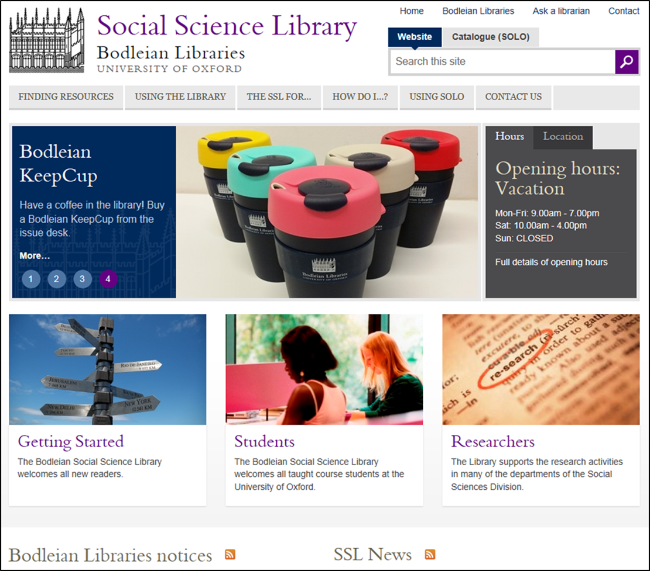
http://www.bodleian.ox.ac.uk/ssl

Slide 22
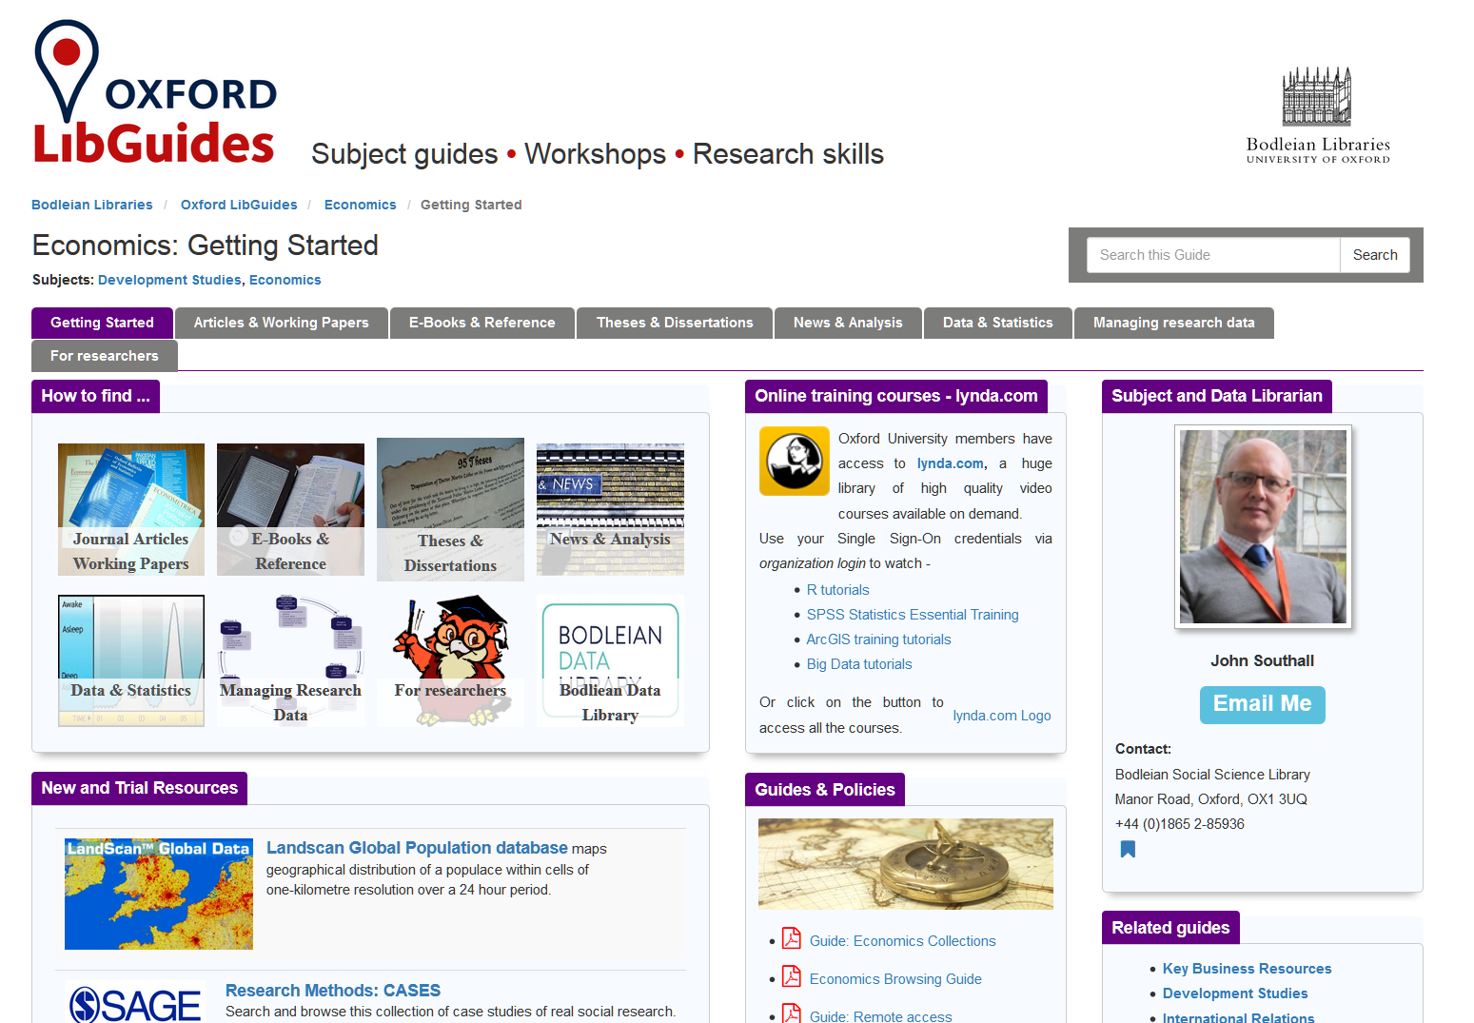
Subject Libguides
http://ox.libguides.com/economics

Slide 23
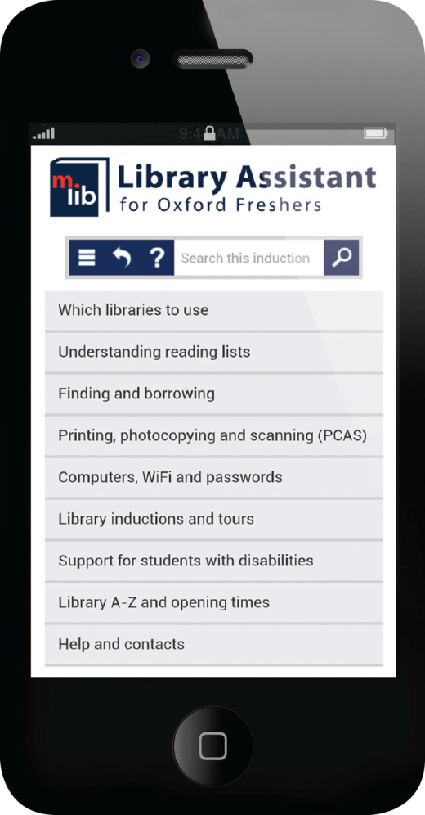
Library Assistant
All your library info…on the go!
Find your libraries
Help on how to get hold of reading list items
Advice on library WiFi, passwords, photocopying and more
Use Library Assistant from your mobile, tablet or PC
www.bodleian.ox.ac.uk/assistant
Notes:
Library Assistant is our new online mobile library induction.
You can use Library Assistant to quickly find key information about using the libraries including the kind of information we’ve covered here today, so don’t worry if you missed anything or if you forget later.
Library Assistant is designed to work on mobile phones and tablets but will also work on desktop and laptop computers so you can use it where ever you are.

Slide 24


http://libguides.bodleian.ox.ac.uk/iskills
Workshops for postgraduates & researchers
Topics covered:
  information discovery and finding scholarly materials
  reference management (Endnote, RefWorks, Zotero & Mendeley)
  measuring research impact
  copyright and intellectual property
  open access publishing
  managing research data

Slide 25

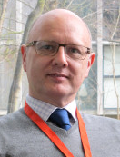


SSL subject librarians
 | Jo Gardner Bodleian Social Science Librarian Manages SSL, taught-courses, research support to DPIR, OII & BSG (2)78721 jo.gardner@bodleian.ox.ac.uk
 | John Southall Social Sciences Data Librarian & Subject Consultant Data enquiries, RDM, research support to ECO, SOC & SPI (2)85936 john.southall@bodleian.ox.ac.uk
John.southall@bodleian.ox.ac.uk | Sarah Rhodes International Development, RSC, African Studies Subject Consultant (2)85998 sarah.rhodes@bodleian.ox.ac.uk
 | Angelina Gibson Russian and Eurasian Subject Consultant (2)71937 angelina.gibson@bodleian.ox.ac.uk

